Slide 1
Protein engineering

Slide 2
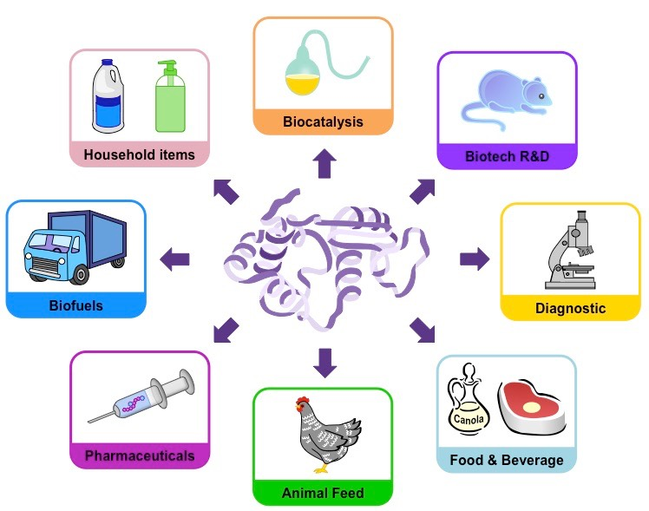
Enzymes
Their activities, specificities and selectivities make them attractive as biocatalysts for a wide variety of industries.
Examples are agrochemicals, detergents, starch, textiles, personal care, pulp and paper, food processing, and animal feed.

Slide 3
Enzymes
Their activities, specificities and selectivities make them attractive as biocatalysts for a wide variety of industries.
Examples are agrochemicals, detergents, starch, textiles, personal care, pulp and paper, food processing, and animal feed.
They are a viable alternative to chemical synthesis, which is usually characterized by low yield and the accumulation of undesirable secondary products.
Natural enzymes are often not optimal for use in industrial conditions.
Desirable changes in the enzyme: substrate specificity, expression level, solubility, stability, activity, selectivity, or thermal stability.
Protein engineering usually involves the modification of amino acid sequences at the DNA sequence level by means of chemical or genetic techniques. The resultant protein is then tested for novel, optimal or improved physical and/or catalytic properties

Slide 4
Protein engineering
There are two different basic approaches:
Rational design: Mutations are introduced at specific places in the protein-encoding gene. Positions to mutagenize are based on the knowledge of possible relationships of sequence, structure, function and/or the catalytic mechanism of the protein. (Sequence- and Structure- based strategies)
Directed evolution: This approach involves repeated cycles of random mutagenesis of and/or recombination with variants of the gene to create a library of genes with slightly different sequences. The enzyme variants thus obtained are submitted to genetic selection or to high-throughput screening to identify those enzyme variants with improvements in the desired property. Directed evolution has been demonstrated to be a very powerful technique, especially for increasing stability or to change the specificity of an enzyme. It is a particularly useful approach, since no structural or mechanistic information is required. In many cases, changes that contribute to the improved properties are far from the active sites.

Slide 5
Approaches for selecting targets to mutagenize
Any biochemical, structural, or protein sequence information may be useful for identifying residues that may influence a desired enzyme property. The information may indicate changes that increase or decrease the overall fitness of the enzyme.
Focusing on regions that may be directly related to the catalytic property. For example, amino acid residues that alter substrate specificity or selectivity are commonly non-conserved residues. They are often in close contact with catalytic residues in or near the active site, cofactors or substrates. Another approach is the identification of sequence motifs that are thought to have been conserved during evolution. In contrast, residues thought to be involved in thermo stabilization are spread throughout the entire sequence. For this reason, random mutagenesis is a powerful tool for achieving protein stabilization.
Increasing protein stability by site-directed mutagenesis strategies. additional disulfide bridges; decrease of loop entropy by replacement of some amino acid residues to P or by the shortening of loops; change of α-helix propensity by mutations to replace G residues (low α-helix propensity) to A residues (high α-helix propensity); or by the introduction of salt bridges to increase electrostatic interactions in the protein.

Slide 6
Sequence-based mutagenesis
Alanine scanning: determine the contribution of the side-chains of specific residues in a protein. Substitution of residues with alanine removes all side chain atoms past the β-carbon, without introducing additional conformational changes into the protein backbone. Although mutagenesis by alanine scanning can be a laborious method it has nevertheless been useful for the study of interactions at protein-protein interfaces or for the identification of residues involved in substrate recognition, protein stability, or binding.
Alternatives to conventional alanine scanning are computational methods for modeling alanine-scanning mutants. This approach has proven to be useful for predicting active-site residues important for activity and to identify amino acid residues important in protein-protein interactions.

Slide 7
Sequence-based mutagenesis
Protein sequence alignment:
residues that are indispensable to function and/or stability have been maintained by selective pressure.
Multiple sequence alignments are useful tools for identifying positions that are unchangeable in a protein.
Analysis of position-specific residue (residue profiles) gives information about amino acid conservation or variability at each position.
It is also useful for identifying important amino acids that probably cannot be modified.

Slide 8
Protein sequence alignment
Correlating amino acid sequence patterns to specific properties:
An approach for identifying residues that may be functionally relevant is to correlate an enzyme property with the amino acid patterns observed in a multiple sequence alignment. For example, comparison of more stable proteins with less stable ones is a strategy for identifying possible thermo stabilizing residues.
Sequence patterns can also be used to identify the determinants of specificity. Good examples are the attempts to change cofactor specificity in dehydrogenases to NAD+
Even distant mutations can significantly affect the properties of an active site. They may alter slightly the geometry, electrostatic properties or dynamics of amino acids in the active site. Distant residues that are important for their interactions with the active site may be seen as conserved in a multiple sequence alignment.

Slide 9
Protein sequence alignment
Consensus sequence:
In the homologous proteins, the consensus amino acid at a given position contributes more to the stability or the function of the protein than does a non-consensus residue.
Consensus sequence may closely mimic the sequence of an ancestral protein which were originally thermophilic or hyperthermophilic.
Consensus sequence has been used to improve the thermostability of several enzymes. This was achieved by mutation of several residues towards the consensus sequence obtained from a multiple sequence alignment.

Slide 10
Protein sequence alignment
Design of ancestral proteins:
Ancestral proteins were able to withstand the harsh conditions prevalent on earth at that time.
Ancestral enzymes may have been promiscuous with respect to substrates.
Because of their low specificity, the ancestral proteins evolved to become more efficient at using specific substrates.
Reconstruction of ancestral sequences from multiple sequence alignments and phylogenetic trees may provide the opportunity to change enzyme specificity.

Slide 11
Structure-based mutagenesis
The evolution of proteins involves mutations of single residues, insertions, deletions gene duplications, fusions, exon duplications and shuffling.
Such changes, which accumulate over time, make the identification of sequence similarities very difficult.
structure is more preserved than sequence and can be used as an evidence of homology among proteins.
Comparative analyses of protein sequences and structures are important approaches for the identification of structural, evolutionary and functional relationships between proteins.
rapidly growing number of protein structures in PDB and advances in Homology Modeling, are of great value for generating structural alignments.

Slide 12
Homology Modeling
these methods provide a measure of structural similarity between proteins.
RMSD
defines the residues that have structurally equivalent positions in the proteins being compared.
Homology modeling can be done even when no sequence similarity is detected.
Based on structural alignments, it is possible to identify residues in direct contact with the substrate or near the active-site cavity.
A more complex analysis can even look into enzyme locations that are far from the active site, but are part of a network of interactions that hold the active site together. The residues at these locations can be targeted for mutagenesis.

