Slide 1
Bioinformatics

Slide 2
WHAT IS BIOINFORMATICS?
Luscombe et al: union of biology and informatics: bioinformatics involves the technology that uses computers for storage, retrieval, manipulation, and distribution of information related to biological macromolecules such as DNA, RNA, and proteins
Difference between Bioinformatics and Computational Biology
computational biology encompasses all biological areas that involve computation
Alternative definition: one version defines bioinformatics as the development and application of computational tools in managing all kinds of biological data, whereas computational biology is more confined to the theoretical development of algorithms used for bioinformatics

Slide 3
Goals
The ultimate goal of bioinformatics is to better understand a living cell and how it functions at the molecular level.
By analyzing raw molecular sequence and structural data, bioinformatics research can generate new insights and provide a “global” perspective of the cell.
The reason that the functions of a cell can be better understood by analyzing sequence data is ultimately because the flow of genetic information is dictated by the “central dogma” of biology
DNA is transcribed to RNA, which is translated to proteins.

Slide 4
SCOPE
Bioinformatics consists of two subfields:
  development of computational tools and databases
  application of these tools and databases in generating biological knowledge
Three areas in the tool and database development:
  Molecular sequence analysis
  Molecular structural analysis
  Molecular functional analysis
Notes:
The tool development includes writing software for sequence structural, and functional analysis, aswell as the construction and curating of biological databases.

Slide 6
APPLICATIONS
knowledge-based drug design
  Knowledge of the three-dimensional structures of proteins allows molecules to be designed that are capable of binding to the receptor site of a target protein with great affinity and specificity. This informatics-based approach significantly reduces the time and cost necessary to develop drugs with higher potency, fewer side effects, and less toxicity than using the traditional trial-and-error approach.
Forensic DNA analysis
  results from molecular phylogenetic analysis have been accepted as evidence in criminal courts.

Slide 7
APPLICATIONS
Medicine
  genomics and bioinformtics are now poised to revolutionize our healthcare system by developing personalized and customized medicine. The high speed genomic sequencing coupled with sophisticated informatics technology will allow a doctor in a clinic to quickly sequence a patient’s genome and easily detect potential harmful mutations and to engage in early diagnosis and effective treatment of diseases.
Agriculture
  Plant genome databases and gene expression profile analyses have played an important role in the development of new crop varieties that have higher productivity and more resistance to disease.

Slide 8
LIMITATIONS
In many ways, the role of bioinformatics in genomics and molecular biology research can be likened to the role of intelligence gathering in battlefields.
Fighting a battle without intelligence is inefficient and dangerous.
Overreliance on poor-quality intelligence can yield costly mistakes if not complete failures.
The outcome of computation also depends on the computing power available. Many accurate but exhaustive algorithms cannot be used because of the slow rate of computation. Instead, less accurate but faster algorithms have to be used. This is a necessary trade-off between accuracy and computational feasibility. Therefore, it is important to keep in mind the potential for errors produced by bioinformatics programs.

Slide 9
Databases
One of the hallmarks of modern genomic research is the generation of enormous amounts of raw sequence data.
the very first challenge in the genomics era is to store and handle the staggering volume of information through the establishment and use of computer databases.
A database is a computerized archive used to store and organize data in such a way that information can be retrieved easily via a variety of search criteria.
The chief objective of the development of a database is to organize data in a set of structured records to enable easy retrieval of information.
Each record, also called an entry, should contain a number of fields that hold the actual data items, for example, fields for names, phone numbers, addresses, dates.
To retrieve a particular record from the database, a user can specify a particular piece of information, called value, to be found in a particular field and expect the computer to retrieve the whole data record. This process is called making a query.

Slide 10
Databases
Although data retrieval is the main purpose of all databases, biological databases often have a higher level of requirement, known as knowledge discovery
knowledge discovery refers to the identification of connections between pieces of information that were not known when the information was first entered.
For example, databases containing raw sequence information can perform extra computational tasks to identify sequence homology or conserved motifs.
These features facilitate the discovery of new biological insights from raw data.
Originally, databases all used a flat file format, which is a long text file that contains many entries separated by a delimiter, a special character such as a vertical bar (|). Within each entry are a number of fields separated by tabs or commas.

Slide 11
Biological databases
Based on their contents, biological databases can be roughly divided into three categories: primary databases, secondary databases, and specialized databases
Primary databases contain original biological data. They are archives of raw sequence or structural data submitted by the scientific community. GenBank and Protein Data Bank (PDB)
Secondary databases contain computationally processed or manually curated information, based on original information from primary databases. Translated protein sequence databases ,SWISS-Prot and Protein Information Resources (PIR)
Specialized databases are those that cater to a particular research interest. For example, Flybase and HIV sequence database are databases that specialize in a particular organism or a particular type of data.

Slide 12
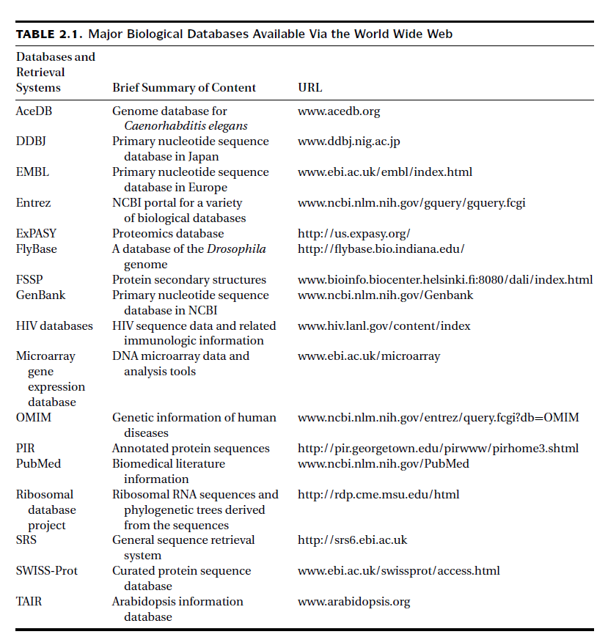

Slide 13



Primary databases: There are three major public sequence databases that store raw nucleic acid sequence data produced and submitted by researchers worldwide: GenBank, the European Molecular Biology Laboratory (EMBL) database and the DNA Data Bank of Japan (DDBJ), which are all freely available on the Internet.
sequence submission to either GenBank, EMBL, or DDBJ is a precondition for publication in most scientific journals to ensure the fundamental molecular data to be made freely available.
They together constitute the International Nucleotide Sequence Database Collaboration.
Notes:
Although the three databases all contain the same sets of raw data, each of the individual databases has a slightly different kind of format to represent the data.

Slide 14
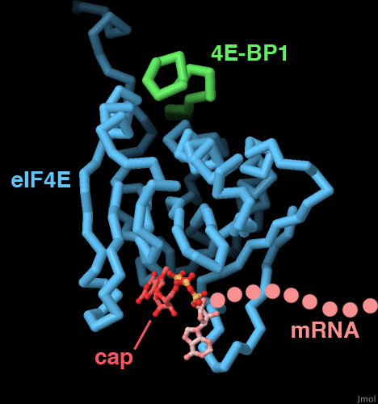

Primary databases: for the three-dimensional structures of biological macromolecules, there is only one centralized database, the PDB.
This database archives atomic coordinates of macromolecules (both proteins and nucleic acids) determined by x-ray crystallography and NMR. It uses a flat file format to represent protein name, authors, experimental details, secondary structure, cofactors, and atomic coordinates.
The web interface of PDB also provides viewing tools for simple image manipulation.

Slide 15
Secondary Databases
Sequence annotation information in the primary database is often minimal. To turn the raw sequence information into more sophisticated biological knowledge, much postprocessing of the sequence information is needed.
secondary databases contain computationally processed sequence information derived from the primary databases.
some are simple archives of translated sequence data from identified open reading frames in DNA. Like TrEMBL, a database of translated nucleic acid sequences stored in the EMBL database.
http://www.bioinfo.pte.hu/more/TrEMBL.htm

Slide 16

Secondary Databases
SWISS-PROT, which provides detailed sequence annotation that includes structure, function, and protein family assignment.
The protein annotation includes function, domain structure, catalytic sites, cofactor binding, posttranslational modification, metabolic pathway information, disease association, and similarity with other sequences.
Much of this information is obtained fromscientific literature and entered by database curators.
The data record also provides crossreferencing links to other online resources of interest.
very low redundancy and high level of integration with other primary and secondary databases make SWISS-PROT very popular among biologists.
https://web.expasy.org/docs/swiss-prot_guideline.html

Slide 17



Secondary Databases
A recent effort to combine SWISS-PROT, TrEMBL, and PIR led to the creation of the UniProt database, which has larger coverage than any one of the three databases while at the same time maintaining the original SWISS-PROT feature of low redundancy, cross-references, and a high quality of annotation.
https://www.uniprot.org/
There are also secondary databases that relate to protein
family classification according to functions or structures.
Notes:
The Pfam and Blocks databases (to be described
in Chapter 7) contain aligned protein sequence information as well as derived motifs
and patterns, which can be used for classification of protein families and inference
of protein functions. The DALI database (to be described in Chapter 13) is a protein
secondary structure database that is vital for protein structure classification and
threading analysis (to be described in Chapter 15) to identify distant evolutionary
relationships among proteins.

Slide 18

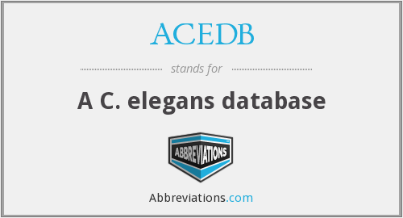
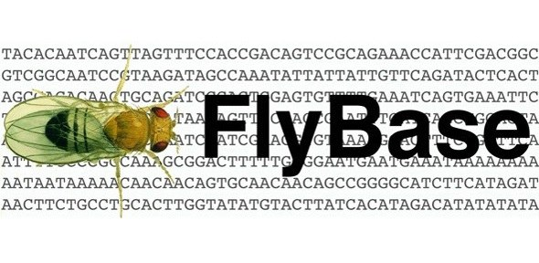

Specialized Databases
Specialized databases normally serve a specific research community or focus on a particular organism. The content of these databases may be sequences or other types of information.
The sequences in these databases may overlap with a primary database, but may also have new data submitted directly by authors. Because they are often curated by experts in the field, they may have unique organizations and additional annotations associated with the sequences.
Many genome databases that are taxonomic specific fall within this category.
Notes:
In addition, there are also specialized databases that contain
original data derived from functional analysis. For example, GenBank EST database
and Microarray Gene Expression Database at the European Bioinformatics Institute
(EBI) are some of the gene expression databases available.

Slide 19
PITFALLS OF BIOLOGICAL DATABASES
One of the problems associated with biological databases is overreliance on sequence information and related annotations, without understanding the reliability of the information.
Redundancy is another major problem affecting primary databases.
The National Center for Biotechnology Information (NCBI) has now created a non redundant database, called RefSeq, in which identical sequences from the same organism and associated sequence fragments are merged into a single entry.
The other common problem is erroneous annotations. Often, the same gene sequence is found under different names resulting in multiple entries and confusion about the data. Or conversely, unrelated genes bearing the same name are found in the databases. A prominent example of such systems is Gene Ontology.
Some of the inconsistencies in annotation could be caused by genuine disagreement between researchers in the field; others may result from imprudent assignment of protein functions by sequence submitters.

Slide 20
INFORMATION RETRIEVAL FROM BIOLOGICAL DATABASES
major goal in developing databases is to provide efficient and user friendly access to the data stored.
The most popular retrieval systems for biological databases are Entrez that provide access to multiple databases for retrieval of integrated search results.
To perform complex queries in a database often requires the use of Boolean operators (AND, OR, NOT)
The NCBI developed and maintains Entrez, a biological database retrieval system. It is a gateway that allows text-based searches for a wide variety of data, including annotated genetic sequence information, structural information, as well as citations and abstracts, full papers, and taxonomic data.
The key feature of Entrez is its ability to integrate information, which comes from cross-referencing between NCBI databases based on preexisting and logical relationships between individual entries.

Slide 21
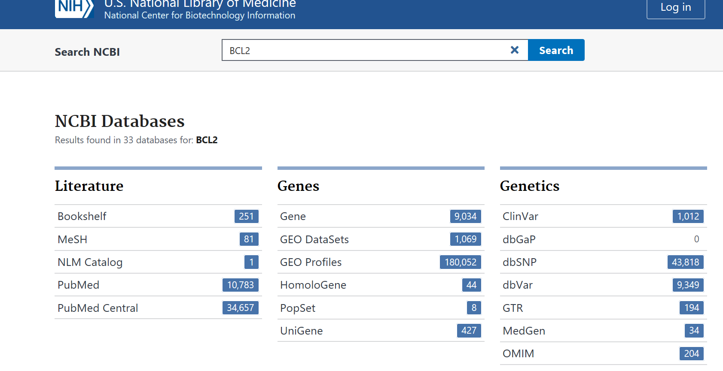

Slide 22
GenBank Sequence Format
To search GenBank effectively using the text based method requires an understanding of the GenBank sequence format.
The resulting flat files contain three sections – Header, Features, and Sequence entry.
The Header section describes the origin of the sequence, identification of the organism, and unique identifiers associated with the record.
The top line of the Header section is the Locus, which contains a unique database identifier for a sequence location in the database
The identifier is followed by sequence length and molecule type (e.g., DNA or RNA). This is followed by a three-letter code for GenBank divisions.
PLN for plant, fungal, and algal sequences; PRI for primate sequences; MAM for nonprimate mammalian sequences; BCT for bacterial sequences; and EST for EST sequences.

Slide 23
GenBank Sequence Format
Next to the division is the date when the record was made public
“DEFINITION,” provides the summary information for the sequence record
This is followed by an accession number for the sequence
It has two different formats: two letters with five digits or one letter with six digits.
XM_ (mRNA), XR_ (non-coding RNA), and XP_ (protein) [X for model transcript]
NM_ (mRNA), NR_ (non-coding RNA), and NP_ (protein) [N for curated transcript]
version number
The “Features” section includes annotation information about the gene and gene product, as well as regions of biological significance reported in the sequence, with identifiers and qualifiers. The “Source” field provides the length of the sequence, the scientific name of the organism, and the taxonomy identification number.
The third section of the flat file is the sequence itself
Notes:
sequence-tagged site (or STS) is a short (200 to 500 base pair) DNA sequence that has a single occurrence in the genome and whose location and base sequence are known.

Slide 24
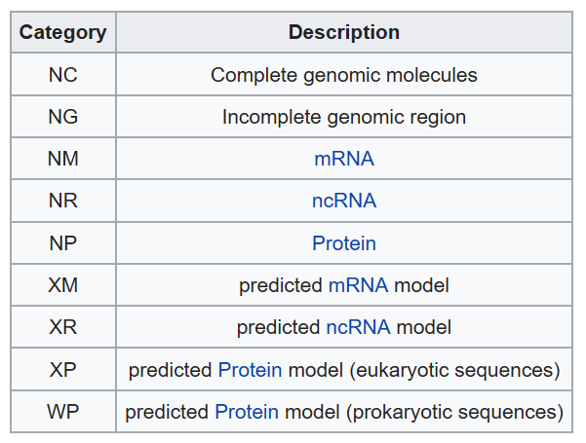

Slide 25
FASTA
FASTA is one of the simplest and the most popular sequence formats because it contains plain sequence information that is readable by many bioinformatics analysis programs.
It has a single definition line that begins with a right angle bracket (>) followed by a sequence name
Sometimes, extra information or comments can be given, which are separated from the sequence name by a “|” symbol.
The extra information is considered optional and is ignored by sequence analysis programs.
The plain sequence in standard one-letter symbols starts in the second line. Each line of sequence data is limited to sixty to eighty characters in width.
The drawback of this format is that much annotation information is lost.

Slide 26
FASTA
Get BCL2 FASTA

Slide 27
Conversion of Sequence Formats
In sequence analysis and phylogenetic analysis, there is a frequent need to convert between sequence formats.
One of the most popular computer programs for sequence format conversion is Readseq
It recognizes sequences in almost any format and writes a new file In an alternative format.
http://iubio.bio.indiana.edu/cgi-bin/readseq.cgi/.

Slide 28
Sequence Alignment

Slide 29
Sequence Alignment
Sequence comparison lies at the heart of bioinformatics analysis.
It is an important first step toward structural and functional analysis of newly determined sequences.
As new biological sequences are being generated at exponential rates, sequence comparison is becoming increasingly important to draw functional and evolutionary inference of a new protein with proteins already existing in the database.
The most fundamental process in this type of comparison is sequence alignment.
This is the process by which sequences are compared by searching for common character patterns and establishing residue–residue correspondence among related sequences.
Pairwise sequence alignment is the process of aligning two sequences and is the basis of database similarity searching and multiple sequence alignment

Slide 30
EVOLUTIONARY BASIS
DNA and proteins are products of evolution.
The building blocks of these biological macromolecules, nucleotide bases, and amino acids form linear sequences that determine the primary structure of the molecules.
These molecules can be considered molecular fossils that encode the history of millions of years of evolution.
During this time period, the molecular sequences undergo random changes, some of which are selected during the process of evolution.
As the selected sequences gradually accumulate mutations and diverge over time, traces of evolution may still remain in certain portions of the sequences to allow identification of the common ancestry.
Some of the residues that perform key functional and structural roles tend to be preserved by natural selection; other residues that may be less crucial for structure and function tend to mutate more frequently.
For example, active site residues of an enzyme family tend to be conserved because they are responsible for catalytic functions.

Slide 31
EVOLUTIONARY BASIS
The degree of sequence conservation in the alignment reveals evolutionary relatedness of different sequences, whereas the variation between sequences reflects the changes that have occurred during evolution in the form of substitutions, insertions, and deletions.
Identifying the evolutionary relationships between sequences helps to characterize the function of unknown sequences.
When a sequence alignment reveals significant similarity among a group of sequences, they can be considered as belonging to the same family
If one member within the family has a known structure and function, then that information can be transferred to those that have not yet been experimentally characterized.
Therefore, sequence alignment can be used as basis for prediction of structure and function of uncharacterized sequences.
If the two sequences share significant similarity, it is extremely unlikely that the extensive similarity between the two sequences has been acquired randomly, meaning that the two sequences must have derived from a common evolutionary origin.

Slide 32
SEQUENCE HOMOLOGY VERSUS SEQUENCE SIMILARITY
Homology: when two sequences are descended from a common evolutionary origin.
Sequence similarity, which is the percentage of aligned residues that are similar in physiochemical properties such as size, charge, and hydrophobicity.
Sequence homology is an inference or a conclusion about a common ancestral relationship drawn from sequence similarity comparison when the two sequences share a high enough degree of similarity.
Similarity is a direct result of observation from the sequence alignment.

Slide 33
SEQUENCE HOMOLOGY VERSUS SEQUENCE SIMILARITY
Sequence similarity can be quantified using percentages; homology is a qualitative statement. For example, one may say that two sequences share 40% similarity. It is incorrect to say that the two sequences share 40% homology.
Generally, if the sequence similarity level is high enough, a common evolutionary relationship can be inferred.
In dealing with real research problems, the issue of at what similarity level can one infer homologous relationships is not always clear.
The answer depends on the type of sequences being examined and sequence lengths.

Slide 34
SEQUENCE HOMOLOGY VERSUS SEQUENCE SIMILARITY
Nucleotide sequences consist of only four characters, and therefore, unrelated sequences have at least a 25% chance of being identical.
For protein sequences, there are twenty possible amino acid residues, and so two unrelated sequences can match up 5% of the residues by random chance.
Sequence length is also a crucial factor.
The shorter the sequence, the higher the chance that some alignment is attributable to random chance. The longer the sequence, the less likely the matching at the same level of similarity is attributable to random chance.
This suggests that shorter sequences require higher cutoffs for inferring homologous relationships than longer sequences.

Slide 35
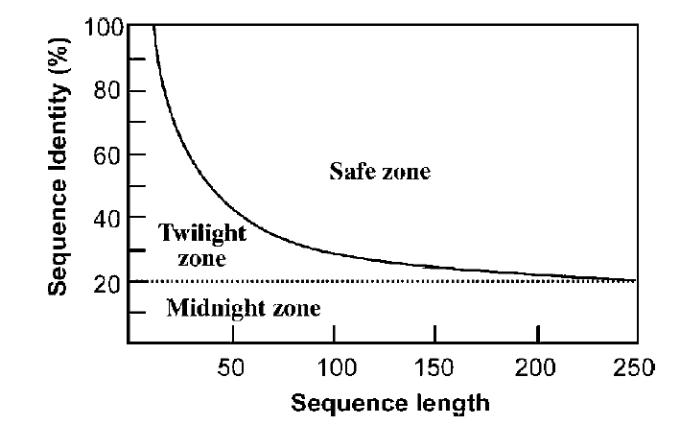
SEQUENCE HOMOLOGY VERSUS SEQUENCE SIMILARITY

Slide 36
SEQUENCE SIMILARITY VERSUS SEQUENCE IDENTITY
Sequence similarity and sequence identity are synonymous for nucleotide sequences.
In a protein sequence alignment, sequence identity refers to the percentage of matches of the same amino acid residues between two aligned sequences.
Similarity refers to the percentage of aligned residues that have similar physicochemical characteristics and can be more readily substituted for each other.
There are two ways to calculate the sequence similarity/identity. One involves the use of the overall sequence lengths of both sequences; the other normalizes by the size of the shorter sequence.

Slide 37
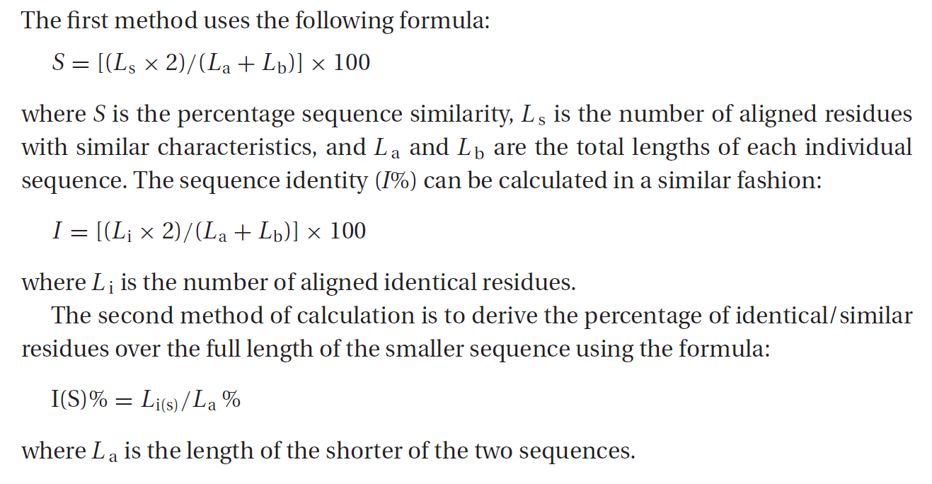
SEQUENCE SIMILARITY VERSUS SEQUENCE IDENTITY

Slide 38
pairwise sequence alignment
The overall goal of pairwise sequence alignment is to find the best pairing of two sequences, such that there is maximum correspondence among residues. To achieve this goal, one sequence needs to be shifted relative to the other to find the position where maximum matches are found. There are two different alignment strategies that are often used: global alignment and local alignment.

Slide 39
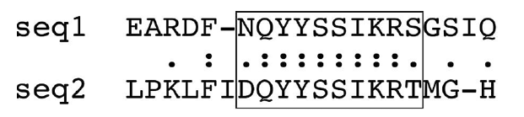
Global alignment
In global alignment, two sequences to be aligned are assumed to be generally similar over their entire length.
Alignment is carried out from beginning to end of both sequences to find the best possible alignment across the entire length between the two sequences.
This method is more applicable for aligning two closely related sequences of roughly the same length.
For divergent sequences and sequences of variable lengths, this method may not be able to generate optimal results because it fails to recognize highly similar local regions between the two sequences.

Slide 40
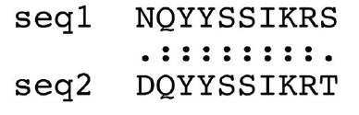
Local alignment
does not assume that the two sequences in question have similarity over the entire length.
It only finds local regions with the highest level of similarity between the two sequences and aligns these regions without regard for the alignment of the rest of the sequence regions.
This approach can be used for aligning more divergent sequences with the goal of searching for conserved patterns in DNA or protein sequences.
The two sequences to be aligned can be of different lengths.
This approach is more appropriate for aligning divergent biological sequences containing only modules that are similar, which are referred to as domains or motifs.

Slide 41
Alignment Algorithms
Both types of algorithms can be based on one of the three methods: the dot matrix method, the dynamic programming method, and the word method.
Dot Matrix Method (dot plot method)
It is a graphical way of comparing two sequences in a two dimensional matrix.
two sequences to be compared are written in the horizontal and vertical axes of the matrix.
The comparison is done by scanning each residue of one sequence for similarity with all residues in the other sequence.
If a residue match is found, a dot is placed within the graph. Otherwise, the matrix positions are left blank.
When the two sequences have substantial regions of similarity, many dots line up to form contiguous diagonal lines, which reveal the sequence alignment.
If there are interruptions in the middle of a diagonal line, they indicate insertions or deletions.
Parallel diagonal lines within the matrix represent repetitive regions of the sequences

Slide 42
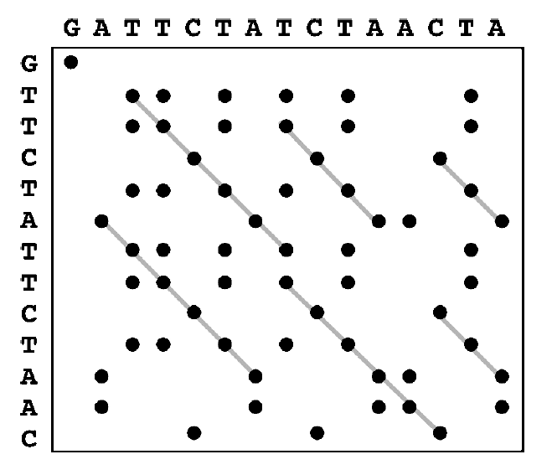

Slide 43
Dot plot
High noise level in dot plot
In most dot plots, dots are plotted all over the graph, obscuring identification of the true alignment.
For DNA sequences, the problem is particularly acute because there are only four possible characters in DNA.
To reduce noise, instead of using a single residue to scan for similarity, a filtering technique has to be applied, which uses a “window” of fixed length covering a stretch of residue pairs.
When applying filtering, windows slide across the two sequences to compare all possible stretches.
Dots are only placed when a stretch of residues equal to the window size from one sequence matches completely with a stretch of another sequence.

Slide 44
Applications of dot plot
A sequence can be aligned with itself to identify internal repeat elements.
In the self comparison, there is a main diagonal for perfect matching of each residue.
If repeats are present, short parallel lines are observed above and below the main diagonal.
Self complementarity of DNA sequences (also called inverted repeats) can also be identified using a dot plot.
In this case, a DNA sequence is compared with its revers complemented sequence.
Parallel diagonals represent the inverted repeats.

Slide 45
Dot plot
The dot matrix method gives a direct visual statement of the relationship between two sequences and helps easy identification of the regions of greatest similarities.
One particular advantage of this method is in identification of sequence repeat regions based on the presence of parallel diagonals of the same size vertically or horizontally in the matrix.
It is often up to the user to construct a full alignment with insertions and deletions by linking nearby diagonals.
Another limitation of this visual analysis method is that it lacks statistical rigor in assessing the quality of the alignment.
The method is also restricted to pairwise alignment.

Slide 46
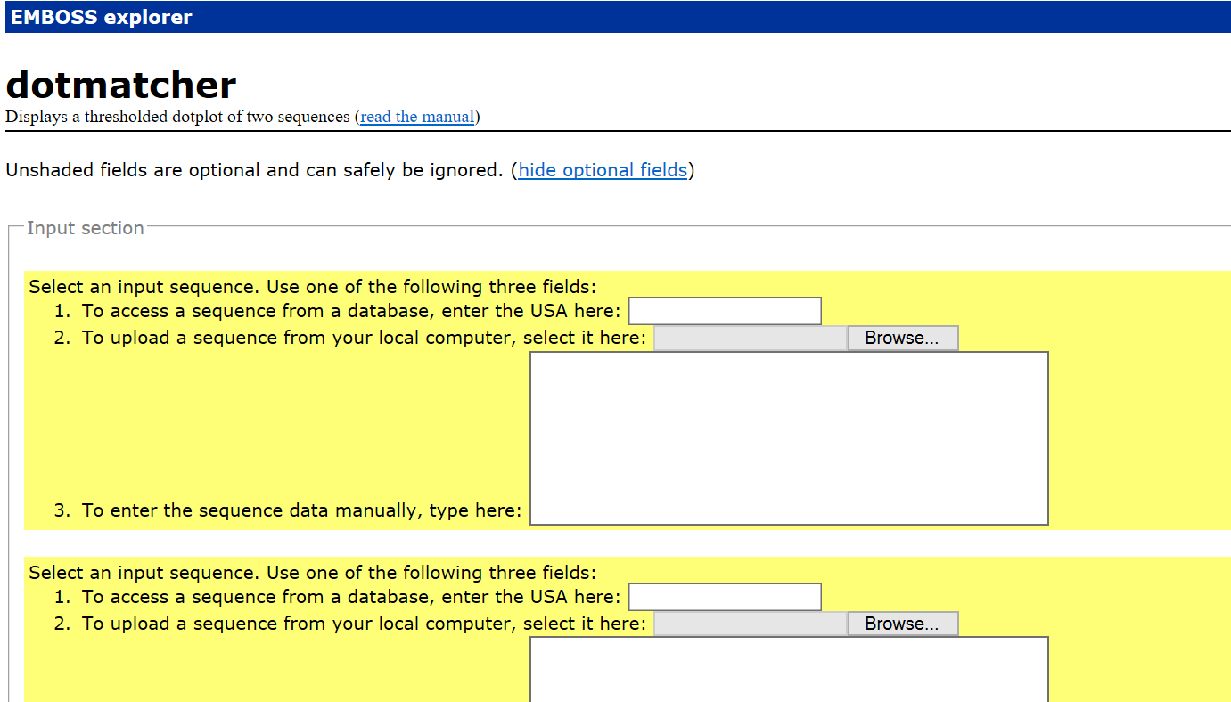

Slide 47
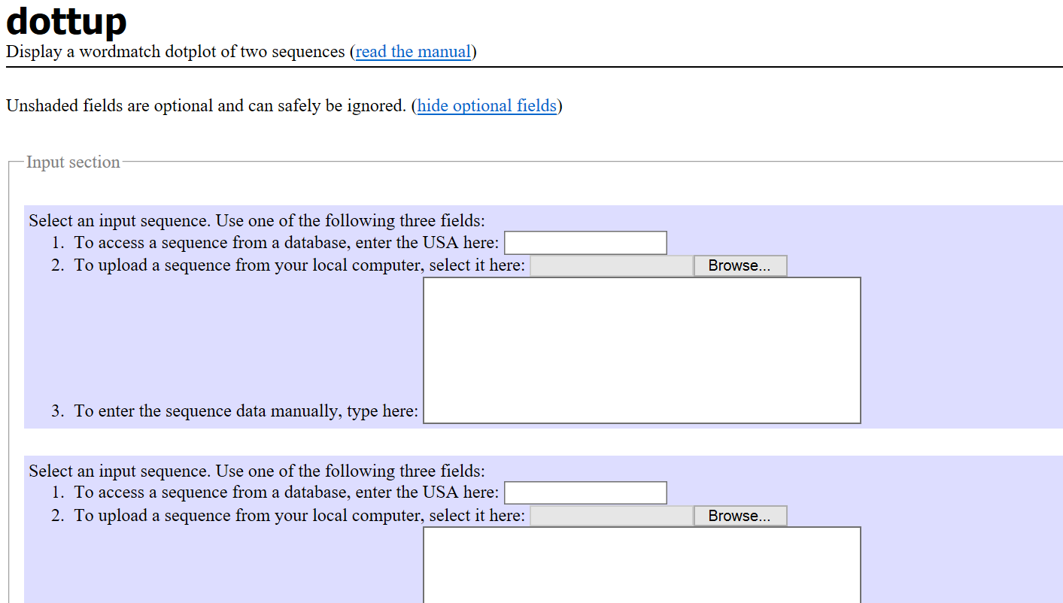
Notes:
Dottup aligns sequence using the word method (to be described in Chapter 4) and is capable of handling
genome-length sequences.

Slide 48
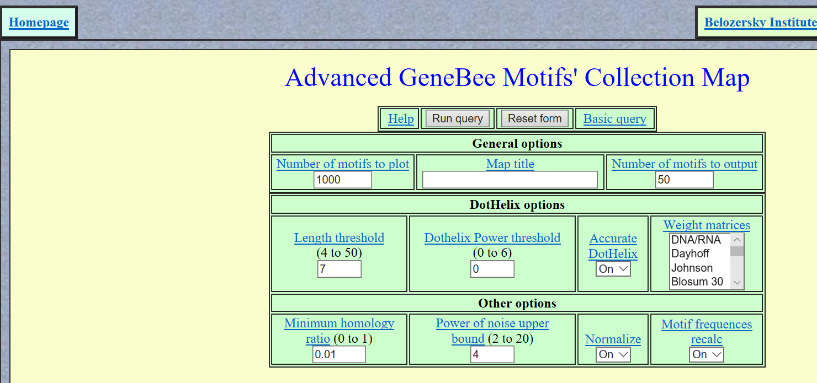

Slide 49
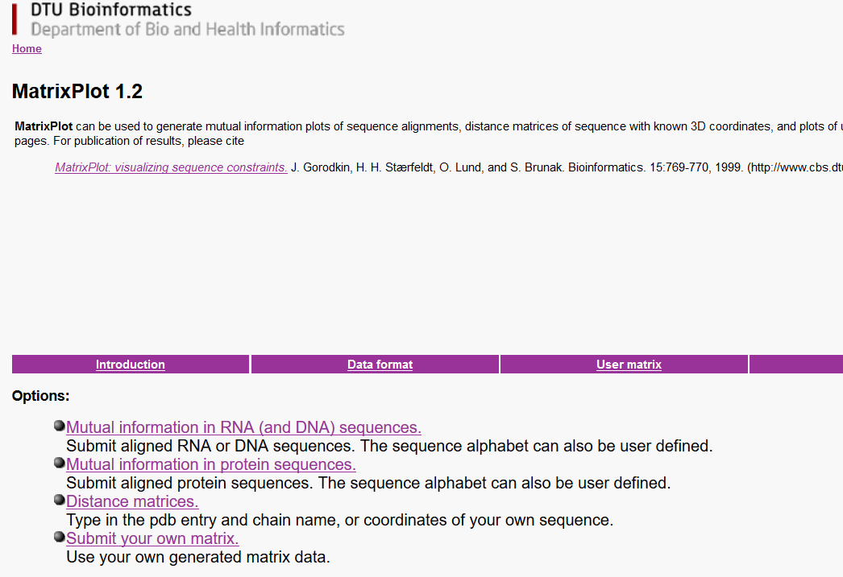
Notes:
Instead of using dots and lines, the program uses colored grids to indicate
alignment or other user-defined information.

Slide 50
Dynamic Programming Method
Dynamic programming is a method that determines optimal alignment by matching two sequences for all possible pairs of characters between the two sequences.
It is fundamentally similar to the dot matrix. However, it finds alignment in a more quantitative way by converting a dot matrix into a scoring matrix to account for matches and mismatches between sequences.
By searching for the set of highest scores in this matrix, the best alignment can be accurately obtained.
Dynamic programming works by first constructing a two-dimensional matrix whose axes are the two sequences to be compared.
The residue matching is according to a particular scoring matrix.

Slide 51
Dynamic Programming Method
The scores are calculated one row at a time.
This starts with the first row of one sequence, which is used to scan through the entire length of the other sequence, followed by scanning of the second row.
The matching scores are calculated.
The scanning of the second row takes into account the scores already obtained in the first round.
The best score is put into the bottom right corner of an intermediate matrix
This process is iterated until values for all the cells are filled.

Slide 52
Dynamic Programming Method
Thus, the scores are accumulated along the diagonal going from the upper left corner to the lower right corner.
Once the scores have been accumulated in matrix, the next step is to find the path that represents the optimal alignment.
This is done by tracing back through the matrix in reverse order from the lower right-hand corner of the matrix toward the origin of the matrix in the upper left-hand corner.
The best matching path is the one that has the maximum total score.
The path can also move horizontally or vertically at a certain point, which corresponds to introduction of a gap or an insertion or deletion for one of the two sequences. (gap penalty, opening gap penalty, extending gap penalty)

Slide 53
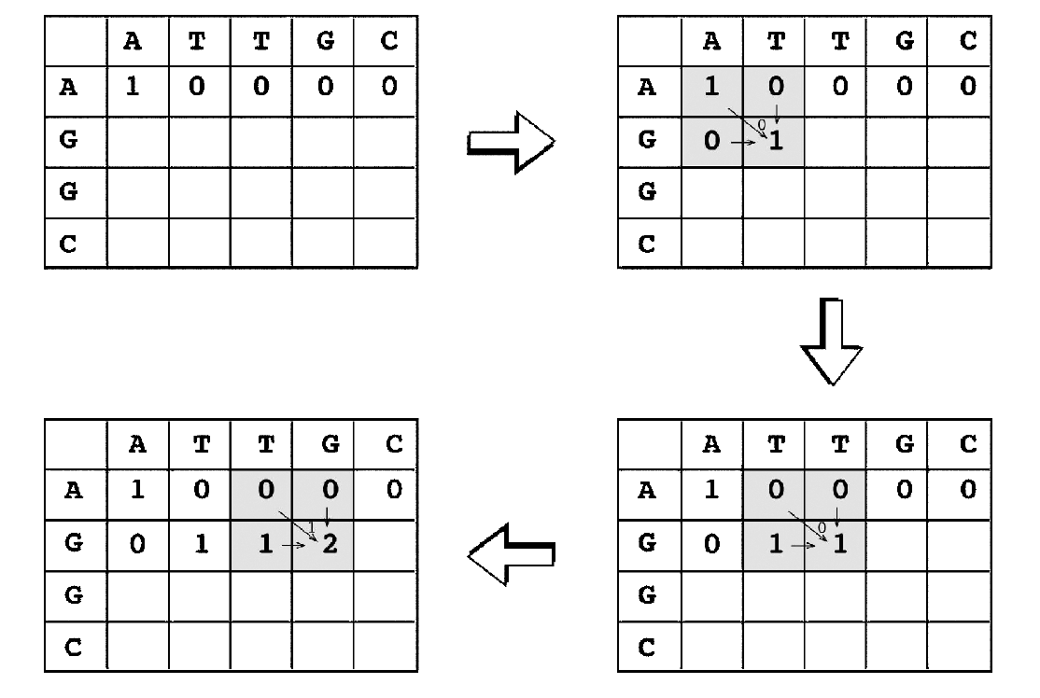

Slide 54
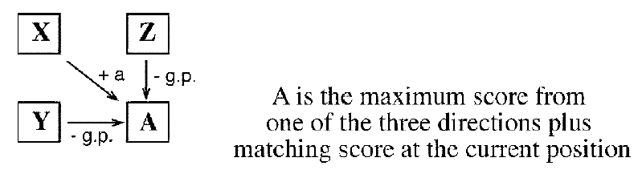

Slide 55
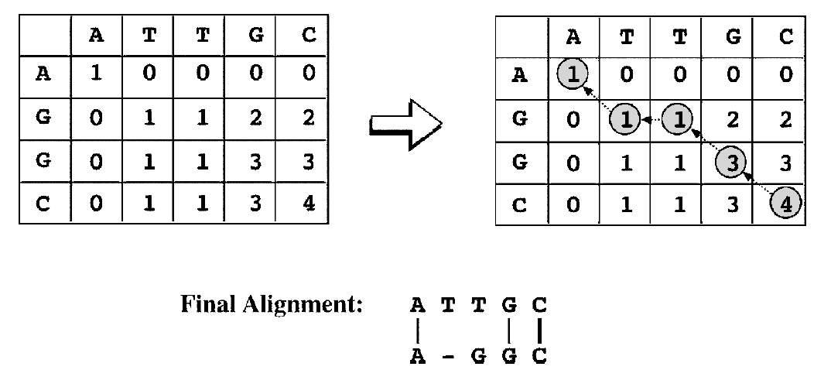

Slide 56
Dynamic Programming for Global Alignment
The classical global pairwise alignment algorithm using dynamic programming is the Needleman–Wunsch algorithm.
In this algorithm, an optimal alignment is obtained over the entire lengths of the two sequences.
It must extend from the beginning to the end of both sequences to achieve the highest total score.
In other words, the alignment path has to go from the bottom right corner of the matrix to the top left corner.
The drawback of focusing on getting a maximum score for the full-length sequence alignment is the risk of missing the best local similarity.
This strategy is only suitable for aligning two closely related sequences that are of the same length. For divergent sequences or sequences with different domain structures, the approach does not produce optimal alignment.

Slide 57
Dynamic Programming for Local Alignment
In regular sequence alignment, the divergence level between the two sequences to be aligned is not easily known.
The sequence lengths of the two sequences may also be unequal.
Smith–Waterman algorithm
several optimally aligned segments with best scores are obtained.
The goal of local alignment is to get the highest alignment score locally, which may be at the expense of the highest possible overall score for a full-length alignment.
This approach may be suitable for aligning divergent sequences or sequences with multiple domains that may be of different origins.

Slide 58
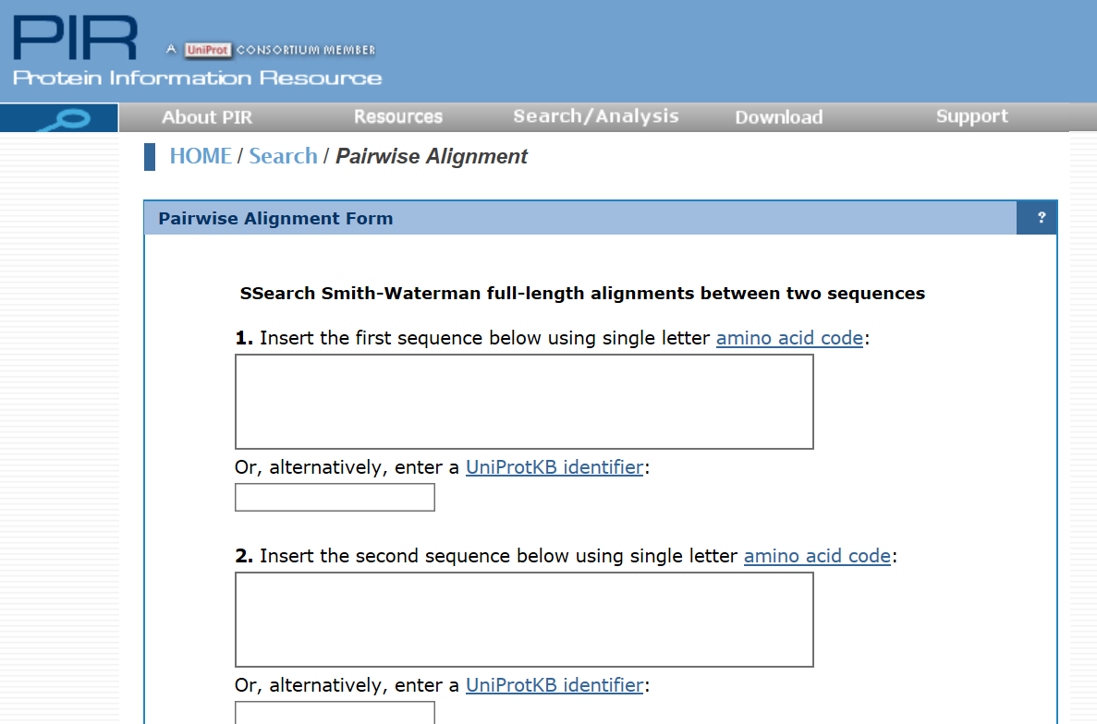

Slide 59
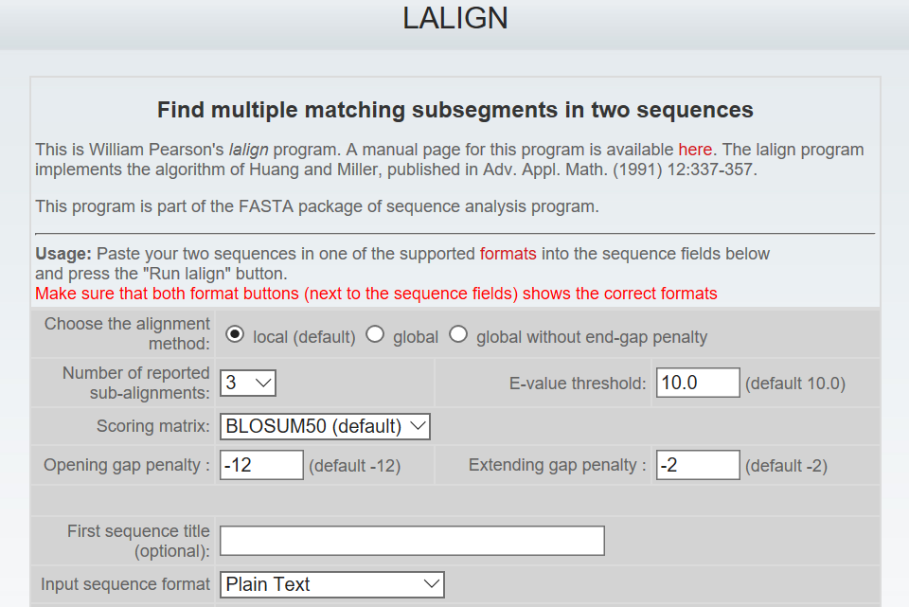

Slide 60
SCORING MATRICES
In the dynamic programming algorithm presented, the alignment procedure has to make use of a scoring system, which is a set of values for quantifying the likelihood of one residue being substituted by another in an alignment.
The scoring systems is called a substitution matrix and is derived from statistical analysis of residue substitution data from sets of reliable alignments of highly related sequences.
Scoring matrices for nucleotide sequences are relatively simple. A positive value or high score is given for a match and a negative value or low score for a mismatch.
This assignment is based on the assumption that the frequencies of mutation are equal for all bases.
However, this assumption may not be realistic; observations show that transitions occur more frequently than transversions.

Slide 61
PROTEIN SCORING MATRICES
Scoring matrices for amino acids are more complicated because scoring has to reflect the physicochemical properties of aminoacid residues, as well as the likelihood of certain residues being substituted among true homologous sequences.
Certain amino acids with similar physicochemical properties can be more easily substituted than those without similar characteristics. Substitutions among similar residues are likely to preserve the essential functional and structural features.
Amino acid substitution matrices, which are 20 × 20 matrices, have been devised to reflect the likelihood of residue substitutions.
Notes:
Hydrophobe with hydrophobe , acidic with acidic, basic with basic but cysteine glycine and proline don’t have similar.

Slide 62
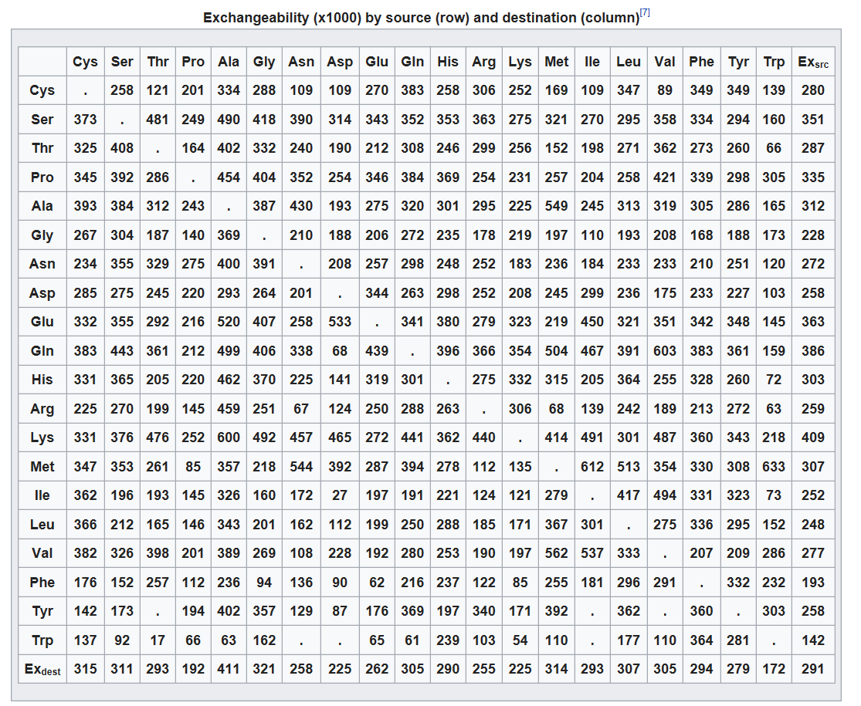
Notes:
Hydrophobe with hydrophobe , acidic with acidic, basic with basic but cysteine glycine and proline don’t have similar.

Slide 63
PROTEIN SCORING MATRICES
Scoring matrices for amino acids are more complicated because scoring has to reflect the physicochemical properties of aminoacid residues, as well as the likelihood of certain residues being substituted among true homologous sequences.
Certain amino acids with similar physicochemical properties can be more easily substituted than those without similar characteristics. Substitutions among similar residues are likely to preserve the essential functional and structural features.
Amino acid substitution matrices, which are 20 × 20 matrices, have been devised to reflect the likelihood of residue substitutions.
There are essentially two types of amino acid substitution matrices.
One type is based on interchangeability of the genetic code or amino acid properties, and the other is derived from empirical studies of amino acid substitutions.
First approach has been shown to be less accurate than the second approach.
Notes:
Hydrophobe with hydrophobe , acidic with acidic, basic with basic but cysteine glycine and proline don’t have similar.

Slide 64
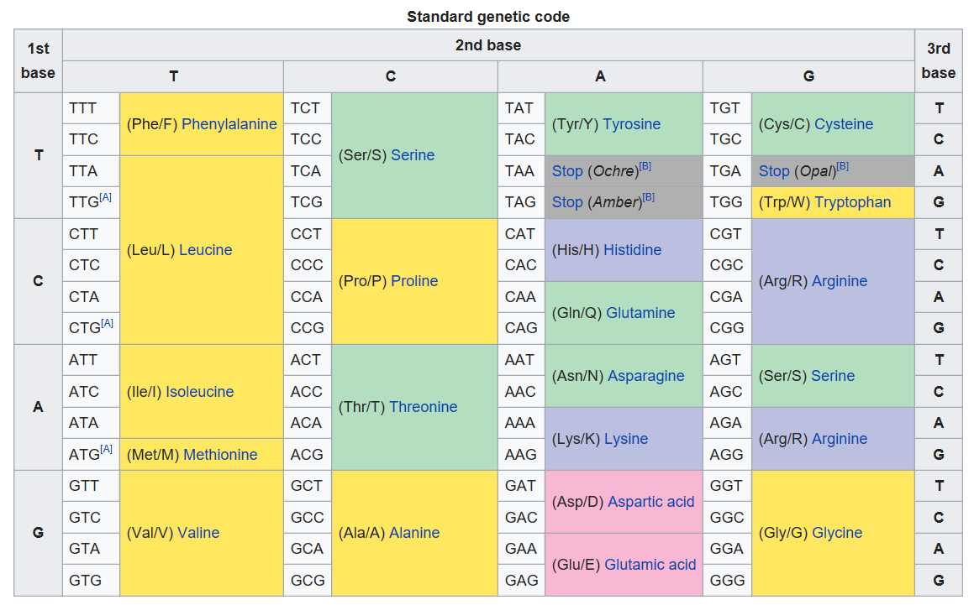
Notes:
Hydrophobe with hydrophobe , acidic with acidic, basic with basic but cysteine glycine and proline don’t have similar.

Slide 65
PROTEIN SCORING MATRICES
The empirical matrices, which include PAM and BLOSUM matrices, are derived from actual alignments of highly similar sequences.
By analyzing the probabilities of amino acid substitutions in these alignments, a scoring system can be developed by giving a high score for a more likely substitution and a low score for a rare substitution.
A positive score means that the frequency of amino acid substitutions found in a data set of homologous sequences is greater than would have occurred by random chance. They represent substitutions of very similar residues or identical residues.
Notes:
Hydrophobe with hydrophobe , acidic with acidic, basic with basic but cysteine glycine and proline don’t have similar.

Slide 66
PROTEIN SCORING MATRICES
A zero score means that the frequency of amino acid substitutions found in the homologous sequence data set is equal to that expected by chance. In this case, the relationship between the amino acids is weakly similar at best in terms of physicochemical properties.
A negative score means that the frequency of amino acid substitutions found in the homologous sequence data set is less than would have occurred by random chance. This normally occurs with substitutions between dissimilar residues.

Slide 67
PAM Matrices
The PAM matrices (also called Dayhoff PAM matrices) were first constructed by Margaret Dayhoff, who compiled alignments of seventy-one groups of very closely related protein sequences.
PAM stands for “point accepted mutation” (although “accepted point mutation” or APM may be a more appropriate term, PAM is easier to pronounce).
Because of the use of very closely related homologs, the observed mutations were not expected to significantly change the common function of the proteins. Thus, the observed amino acid mutations are considered to be accepted by natural selection.

Slide 68
Database Similarity Searching
A main application of pairwise alignment is retrieving biological sequences in databases based on similarity.
This process involves submission of a query sequence and performing a pairwise comparison of the query sequence with all individual sequences in a database.
Thus, database similarity searching is pairwise alignment on a large scale.
This type of searching is one of the most effective ways to assign putative functions to newly determined sequences.
However, the dynamic programming method is slow and impractical to use in most cases.
Special search methods are needed to speed up the computational process of sequence comparison.

Slide 69
UNIQUE REQUIREMENTS OF DATABASE SEARCHING
The first criterion is sensitivity, which refers to the ability to find as many correct hits as possible. It is measured by the extent of inclusion of correctly identified sequence members of the same family (True positive).
The second criterion is selectivity, also called specificity, which refers to the ability to exclude incorrect hits (False positive).
The third criterion is speed, which is the time it takes to get results from database searches. Depending on the size of the database, speed sometimes can be a primary concern.
What generally happens is that an increase in sensitivity is associated with decrease in selectivity. A very inclusive search tends to include many false positives. Similarly, an improvement in speed often comes at the cost of lowered sensitivity and selectivity. A compromise between the three criteria often has to be made.

Slide 70
UNIQUE REQUIREMENTS OF DATABASE SEARCHING
There are two fundamental types of algorithms in bioinformatics.
One is the exhaustive type, which uses a rigorous algorithm to find the best or exact solution for a particular problem by examining all mathematical combinations. (Dynamic programming algorithm)
Another is the heuristic type, which is a computational strategy to find an empirical or near optimal solution.
Essentially, this type of algorithms take shortcuts by reducing the search space according to some criteria.
However, the shortcut strategy is not guaranteed to find the best or most accurate solution.
It is often used because of the need for obtaining results within a realistic time frame without significantly sacrificing the accuracy of the computational output.

Slide 71
HEURISTIC DATABASE SEARCHING
Searching a large database using the dynamic programming methods, is too slow and impractical when computational resources are limited.
querying a database of 300,000 sequences using a query sequence of 100 residues took 2–3 hours to complete with a regular computer system at the time.
To speed up the comparison, heuristic methods have to be used.
The heuristic algorithms perform faster searches because they examine only a fraction of the possible alignments examined in regular dynamic programming.
FASTA and BLAST
They are 50–100 times faster than dynamic programming.

Slide 72
HEURISTIC DATABASE SEARCHING
Searching a large database using the dynamic programming methods, is too slow and impractical when computational resources are limited.
querying a database of 300,000 sequences using a query sequence of 100 residues took 2–3 hours to complete with a regular computer system at the time.
To speed up the comparison, heuristic methods have to be used.
The heuristic algorithms perform faster searches because they examine only a fraction of the possible alignments examined in regular dynamic programming.
FASTA and BLAST
They are 50–100 times faster than dynamic programming.

Slide 73
HEURISTIC DATABASE SEARCHING
FASTA and BLAST
They are 50–100 times faster than dynamic programming.
Both BLAST and FASTA use a heuristic word method for fast pairwise sequence alignment.
It works by finding short stretches of identical or nearly identical letters in two sequences.
These short strings of characters are called words, which are similar to the windows used in the dot matrix method.
The basic assumption is that two related sequences must have at least one word in common.
By first identifying word matches, a longer alignment can be obtained by extending similarity regions from the words.

Slide 74
BASIC LOCAL ALIGNMENT SEARCH TOOL (BLAST)
The BLAST program was developed by Stephen Altschul of NCBI in 1990
One of the most popular programs for sequence analysis.
The objective is to find high-scoring un-gapped segments among related sequences.
seeding: The first step is to create a list of words from the query sequence. The list includes every possible word extracted from the query sequence.
Three residues for protein sequences and eleven residues for DNA sequences.
The second step is to search a sequence database for the occurrence of these words. The matching of the words is scored by a given substitution matrix. A word is considered a match if it is above a threshold.

Slide 75
BASIC LOCAL ALIGNMENT SEARCH TOOL (BLAST)
The next step involves pairwise alignment by extending from the words in both directions while counting the alignment score using the same substitution matrix.
The extension continues until the score of the alignment drops below a threshold due to mismatches (the drop threshold is twenty-two for proteins and twenty for DNA).
The resulting contiguous aligned segment pair without gaps is called high-scoring segment pair (HSP).
A recent improvement in the implementation of BLAST is the ability to provide gapped alignment.
In gapped BLAST, the highest scored segment is chosen to be extended in both directions using dynamic programming where gaps may be introduced.

Slide 77
BLAST variants
BLASTN queries nucleotide sequences with a nucleotide sequence database.
BLASTP uses protein sequences as queries to search against a protein sequence database.
BLASTX uses nucleotide sequences as queries and translates them in all six reading frames to produce translated protein sequences, which are used to query a protein sequence database.
TBLASTN queries protein sequences to a nucleotide sequence database.
TBLASTX uses nucleotide sequences, which are translated in all six frames, to search against a nucleotide sequence database that has all the sequences translated in six frames.

Slide 78
Statistical significance
Deriving the statistical measure is slightly different from that for single pairwise sequence alignment; the larger the database, the more unrelated sequence alignments there are.
In BLAST searches, this statistical indicator is known as the E-value (expectation value), and it indicates the probability that the resulting alignments from a database search are caused by random chance.
The E-value is related to the P-value used to assess significance of single pairwise alignment

Slide 80
Statistical significance
BLAST compares a query sequence against all database sequences, and so the E-value is determined by the following formula:
E = m × n × P
where m is the total number of residues in a database, n is the number of residues in the query sequence, and P is the probability that an HSP alignment is a result of random chance.
For example, aligning a query sequence of 100 residues to a database containing a total of 10^12 residues results in a P-value for the ungapped HSP region in one of the database matches of 1 × 1^−20. The E-value, which is the product of the three values, is 100 × 10^12 × 10^−20, which equals 10^−6. It is expressed as 1e − 6 in BLAST output. This indicates that the probability of this database sequence match occurring due to random chance is 10^−6.

Slide 81
Statistical significance
TheE-value provides information about the likelihood that a given sequence match is purely by chance. The lower the E-value, the less likely the database match is a result of random chance and therefore the more significant the match is.
If E < 1e − 50 there should be an extremely high confidence that the database match is a result of homologous relationships.
If E is between 0.01 and 1e − 50, the match can be considered a result of homology.
If E is between 0.01 and 10, the match is considered not significant, but may hint at a tentative remote homology relationship.
If E > 10, the sequences under consideration are either unrelated

Slide 82
Statistical significance
Because the E-value is proportionally affected by the database size, an obvious problem is that as the database grows, the E-value for a given sequence match also increases.
Because the genuine evolutionary relationship between the two sequences remains constant, the decrease in credibility of the sequence match as the database grows means that one may “lose” previously detected homologs as the database enlarges.
A bit score is another prominent statistical indicator used in addition to the Evalue in a BLAST output.
The bit score measures sequence similarity independent of query sequence length and database size and is based on the raw pairwise alignment score.
The bit score provides a constant statistical indicator for searching different databases of different sizes or for searching the same database at different times as the database enlarges.

Slide 83
Low Complexity Regions
For both protein and DNA sequences, there may be regions that contain highly repetitive residues, such as short segments of repeats, or segments that are overrepresented by a small number of residues.
These sequence regions are referred to as low complexity regions (LCRs).
estimates indicate that LCRs account for about 15% of the total protein sequences in public databases.
These elements in query sequences can lead to artificially high alignment scores with unrelated sequences.
To avoid this problem it is important to filter out the problematic regions in both the query and database sequences using a process known as masking.

Slide 84
Low Complexity Regions
There are two types of masking: hard and soft.
Hard masking involves replacing LCR sequences with an ambiguity character such as N for nucleotide residues or X for amino acid residues.
The ambiguity characters are then ignored by the BLAST program.
The drawback is that matching scores with true homologs may be lowered because of shortened alignments.
Soft masking involves converting the problematic sequences to lower case letters, which are ignored in constructing the word dictionary, but are used in word extension and optimization of alignments.

Slide 86
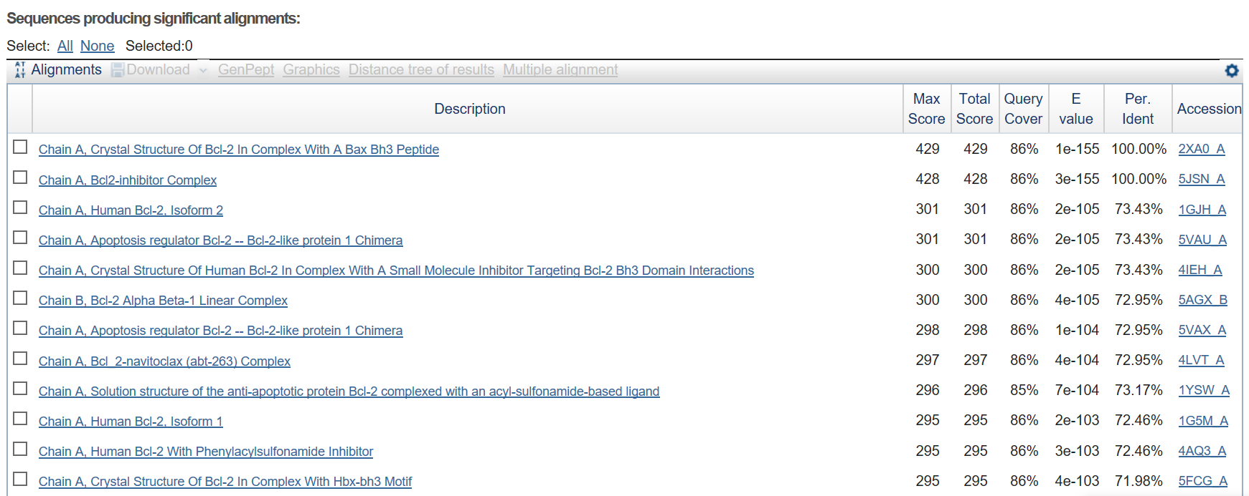

Slide 87
