Slide 1
Hypothalamus
Control Center for
internal environment
Regulates nervous and endocrine systems via 3 mechanisms:
  ANS centers exert nervous control on adrenal medulla
  ADH and Oxytocin production
  Regulatory hormone production (RH and IH) controls pituitary gland directly and all other endocrine glands indirectly
Notes:
The autonomic nervous system (ANS), formerly the vegetative nervous system, is a division of the peripheral nervous system that supplies smooth muscle and glands, and thus influences the function of internal organs.^{[1]} The autonomic nervous system is a control system that acts largely unconsciously and regulates bodily functions such as the heart rate, digestion, respiratory rate, pupillary response, urination, and sexual arousal.^{[2]} This system is the primary mechanism in control of the fight-or-flight response.
consisting of cells that secrete epinephrine (adrenaline), norepinephrine (noradrenaline), and a small amount of dopamine in response to stimulation by sympathetic preganglionic neurons.
هورمون اکسی توسین هورمون پپتیدی است که در تولید مثل جنسی، مکانیسمهای قبل و بعد از زایمان و برئز رفتارهای مادرانه دخیل است. دارو به عنوان محرک انقباضات رحمی، محرک تولید شیر مادر و متوقف کننده خونریزی بعد از زایمان.
هورمون آنتی دیوریتیک یا وازوپرسین باعث کاهش ادرار میشود. باعث افزایش نفوذپذیری سلولی در مجاری جمع کننده ادرار و باعث افزایش بازجذب آب و کاهش حجم ادرار میشود/

Slide 2
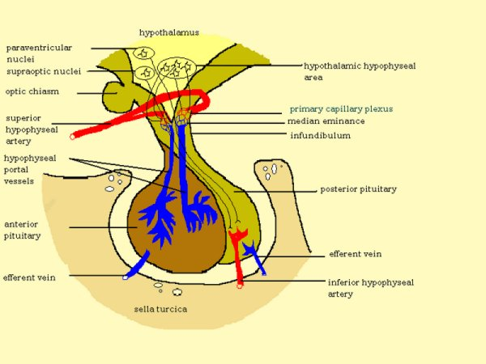
Hypothalamus-Pituitary: Anatomy
Hypothalamus: nervous tissue below thalamus
Pituitary: small outgrowth of the forebrain, size of half a pea
Two functional parts
  Adenohypophysis (anterior pituitary)
  Neurohypophysis (posterior pituitary)
Move together during development
Notes:
هیپوفیز توسط ساقه هیپوفیز از هیپوتالاموس آویزان میباشد

Slide 3
Hypothalamus
Integrates functions that maintain chemical and temperature homeostasis
Functions with the limbic system
Controls the release of hormones from the anterior and posterior pituitary
Notes:
سیستم لیمبیک یا سامانهٔ عصبی احساسی، مجموعهٔ پیچیده‌ای از سازه‌های عصبی است که زیر مخ و در دو طرف نهنج (تالاموس) یافت می‌شود. دستگاه کناره‌ای مجموعه‌ای از ساختارهای مغزی است که در تمام پستانداران وجود دارد و در انجام عمل بویایی و فعالیت‌های دیگر مانند اَعمال خودفرمان و بروز هیجان و سایر رفتارها دخالت دارد.
این دستگاه عامل زندگی احساسی ما و فعالیت‌های مغزی، مانند یادگیری و شکل گرفتن خاطره‌ها می‌باشد. دستگاه کناره‌ای چرایی لذت بخش بودن برخی چیزها، مانند غذا خوردن، و علت برخی بیماری‌ها در اثر فشار روانی، همچون فشار خون بالا را توجیه می‌کند. همچنین این دستگاه تالاموس را به بخشهایی از مخ متصل می‌کند این دستگاه از دو سازهٔ اصلی و چند سازهٔ کوچک‌تر به شرح زیر پایه‌ریزی می‌شود:

Slide 4
Hypothalamus
Synthesizes releasing hormones in cell bodies of neurons
Hormones are transported down the axon and stored in the nerve endings
Hormones are released in pulses

Slide 5
Hypothalamic Releasing Hormones
Seven releasing hormones are made in the hypothalamus
  Thyrotropin-releasing hormone (TRH)
  Corticotropin-releasing hormone (CRH)
  Gonadotropin-releasing hormone (GnRH)
  Growth hormone-releasing hormone (GHRH)
  Growth hormone-release inhibiting hormone (GHIH)
  Prolactin-releasing factor (PRF)
  Prolactin-inhibiting hormone (PIH)

Slide 6
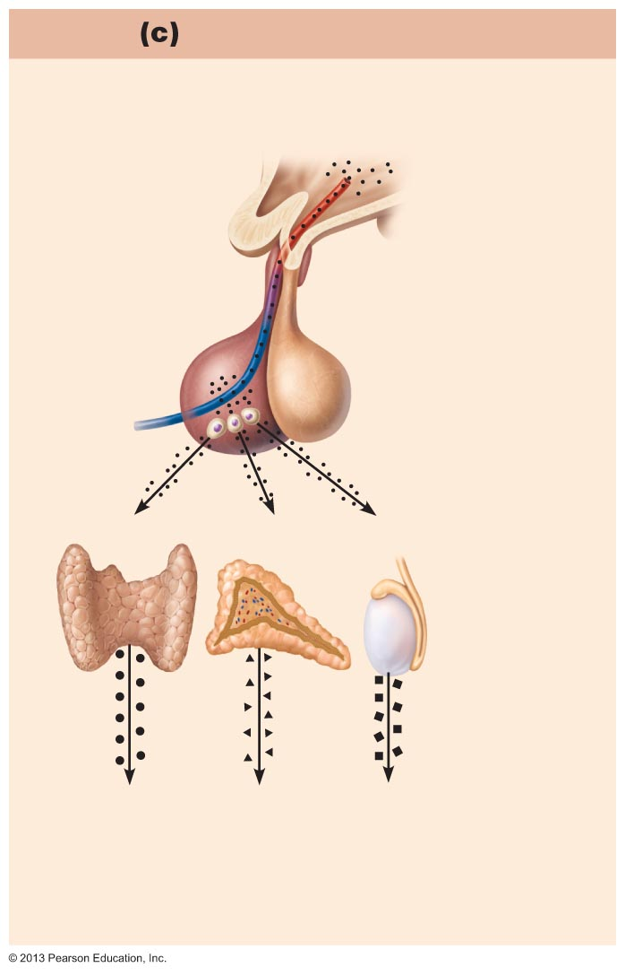
Figure 16.4c Three types of endocrine gland stimuli.
Slide 1
Hormonal Stimulus
Hormone release caused by another
hormone (a tropic hormone).
Hypothalamus
Anterior
pituitary
gland
Thyroid
gland
Adrenal
cortex
Gonad
(Testis)
Stimulus: Hormones from hypothalamus.
Response: Anterior pituitary gland secretes
hormones that stimulate other endocrine
glands to secrete hormones.

Slide 7
Hypothalamus Releasing Hormones: Secretion
Is influenced by emotions
Can be influenced by the metabolic state of the individual
Delivered to the anterior pituitary via the hypothalamic-hypophyseal portal system
Usually initiates a three-hormone sequence

Slide 8
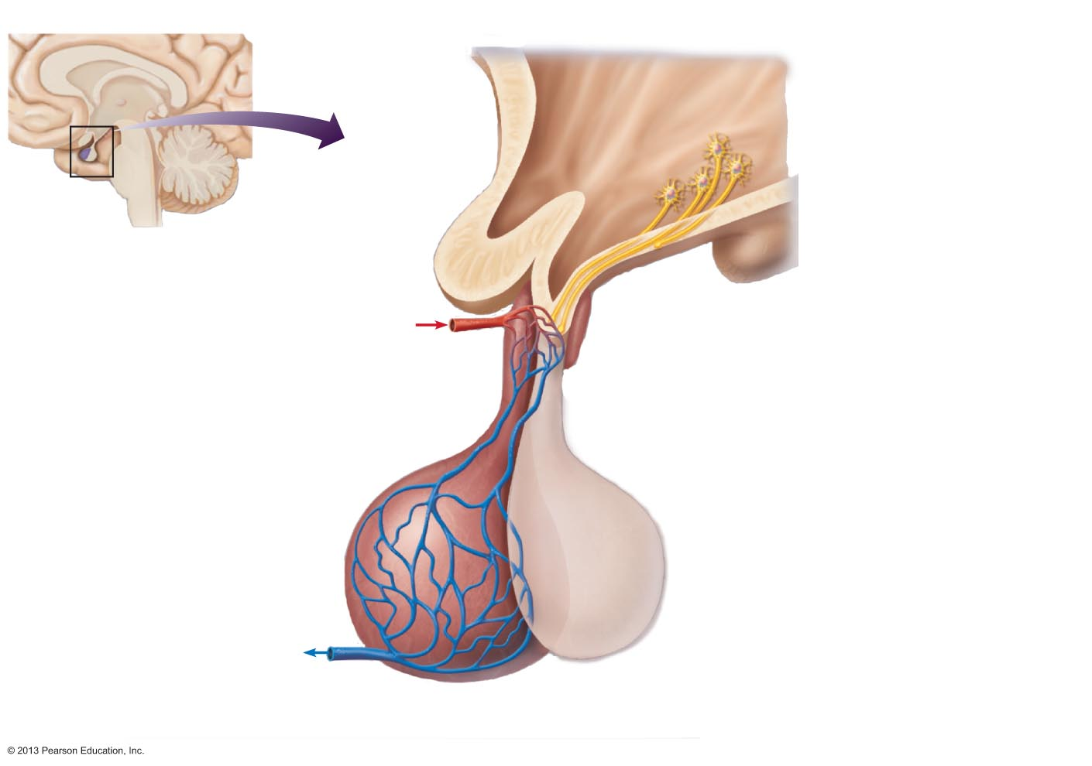
Figure 16.5b The hypothalamus controls release of hormones from the pituitary gland in two different ways (2 of 2).
Slide 1
Hypothalamus
Hypothalamic
neurons synthesize
GHRH, GHIH, TRH,
CRH, GnRH, PIH.
Anterior lobe
of pituitary
Superior
hypophyseal
artery
1
When appropriately stimulated, hypothalamic neurons secrete releasing or inhibiting hormones into the primary capillary plexus.
2
Hypothalamic hormones travel through portal veins to the anterior pituitary where
they stimulate or inhibit
release of hormones made in the anterior pituitary.
Hypophyseal
portal system
3
• Primary capillary
plexus
A portal system is two capillary plexuses (beds) connected by veins.
In response to releasing hormones, the anterior pituitary secretes hormones into the secondary capillary plexus. This in turn empties into the general circulation.
• Hypophyseal
portal veins
• Secondary
capillary plexus
GH, TSH, ACTH,
FSH, LH, PRL
Anterior lobe
of pituitary

Slide 9
Anterior Pituitary
Is also called the Adenohypophysis
Secretes trophic hormones in a pulsatile fashion
Synthesizes various hormones in various specific cell populations

Slide 10
Anterior Pituitary Hormones
Each of anterior pituitary hormone is synthesized by a cell population.
Corticotropes - ACTH
Lactotropes - Prolactin
Somatotropes - GH
Thyrotropes - Thyrotropin
Gonadotropes - FSH, LH

Slide 11
Anterior Pituitary Hormones
Thyroid-stimulating Hormone (TSH): stimulates secretion of thyroid hormone & growth of thyroid gland
Growth Hormone (GH, Somatotropin): primary hormone responsible for regulating body growth, and is important in metabolism
Adrenocorticotropic Hormone (ACTH): stimulates cortisol secretion by the adrenal cortex & promotes growth of adrenal cortex

Slide 12
Anterior Pituitary Hormones
Follicle-stimulating Hormone (FSH): Females: stimulates growth & development of ovarian follicles, promotes secretion of estrogen by ovaries. Males: required for sperm production
Luteinizing Hormone (LH): Females: responsible for ovulation, formation of corpus luteum in the ovary, and regulation of ovarian secretion of female sex hormones. Males: stimulates cell in the testes to secrete testosterone
Prolactin: Females: stimulates breast development and milk production. Males: involved in testicular function
Notes:
جسم زرد (Corpus luteum) یک توده سلولی موقتی در تخمدان خانمهای بارور است که هورمونهای پروژسترون ، استرادیول و اینهیبین A را ترشح میکند.

Slide 13
HYPOTHALAMIC HORMONE | EFFECTS ON THE ANTERIOR PITUITARY
Thyrotropin-releasing hormone (TRH) | Stimulates release of TSH (thyrotropin) and Prolactin
Corticotropin-releasing hormone (CRH) | Stimulates release of ACTH (corticotropin)
Gonadrotropin-releasing hormone (GnRH) | Stimulates release of FSH and LH (gonadotropins)
Growth hormone-releasing hormone (GHRH) | Stimulates release of growth hormone
Growth hormone-inhibiting hormone (GHIH) | Inhibits release of growth hormone
{Prolactin-inhibiting hormone (PIH) | Stimulates release of prolactin
Prolactin-inhibiting hormone (PIH) | Inhibits release of prolactin

Slide 14
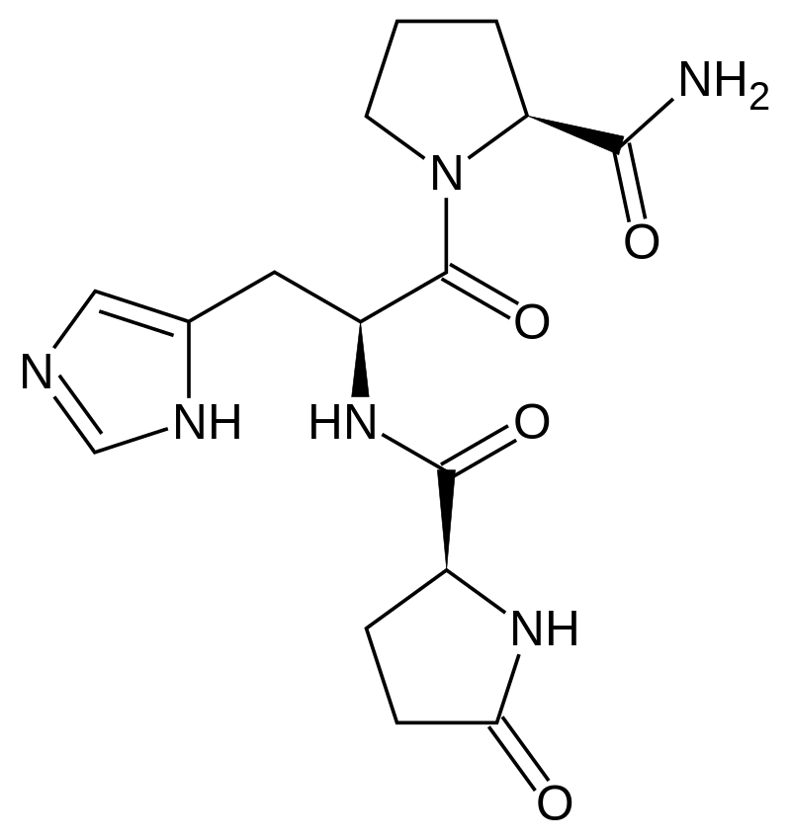
Notes:
TRH is produced by the globe in medial neurons of the paraventricular nucleus.[3] At the beginning, it is synthesized as a 242-amino acid precursor polypeptide that contains 6 copies of the sequence -Gln-His-Pro-Gly-, flanked by Lys-Arg or Arg-Arg sequences.
To produce the mature form, a series of enzymes are required. First, a protease cleaves to the C-terminal side of the flanking Lys-Arg or Arg-Arg. Second, a carboxypeptidase removes the Lys/Arg residues leaving Gly as the C-terminal residue. Then, this Gly is converted into an amide residue by a series of enzymes collectively known as peptidylglycine-alpha-amidating monooxygenase. Concurrently with these processing steps, the N-terminal Gln (glutamine) is converted into pyroglutamate (a cyclic residue). These multiple steps produce 6 copies of the mature TRH molecule per precursor molecule for human TRH (5 for mouse TRH).
Following secretion, TRH travels across the median eminence to the anterior pituitary gland via the hypophyseal portal system where it stimulates the release of thyroid-stimulating hormone from cells called thyrotropes.[4]

Slide 15
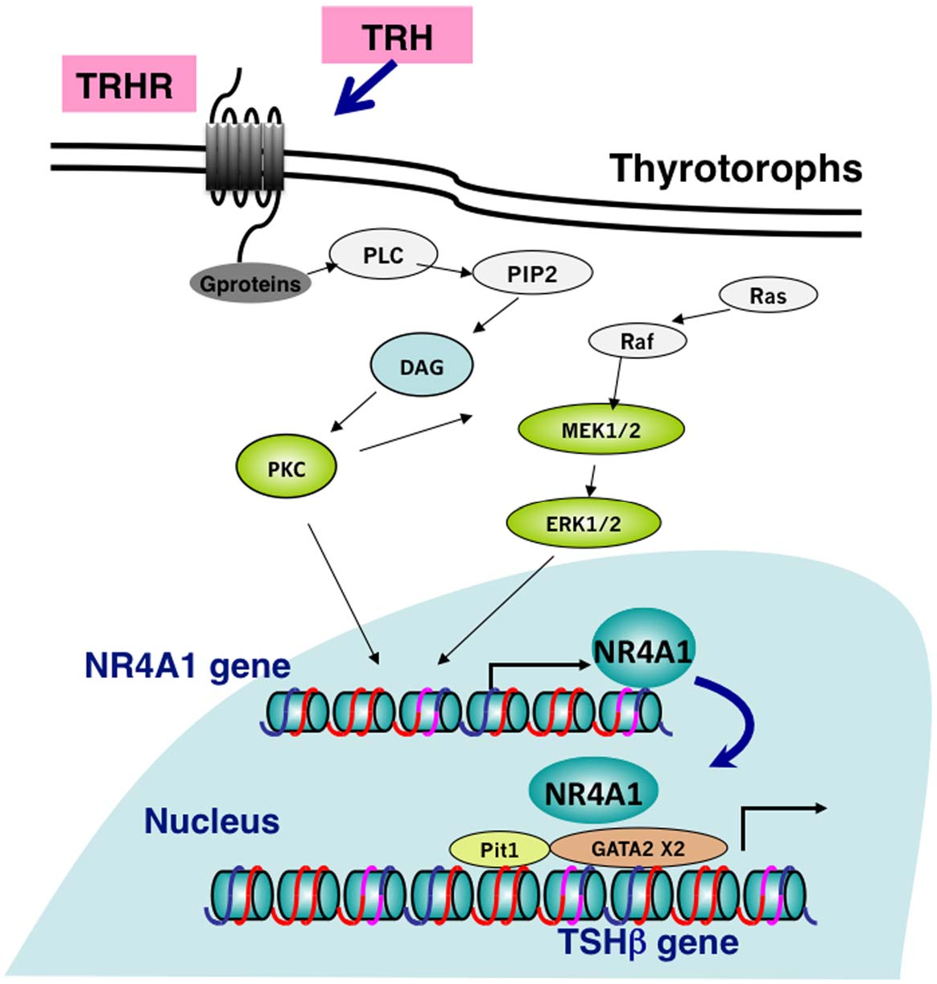
Notes:
TRH stimulates the transcription of the NR4A1 gene through TRH receptors, and PKC and MAPK pathways within 1 hr. The increased amount of NR4A1 stimulates TSHb promoter activity, which may act cooperatively with Pit1 and GATA2 on the gene.
The four human glycoprotein hormones chorionic gonadotropin (CG), luteinizing hormone (LH), follicle stimulating hormone (FSH), and thyroid stimulating hormone (TSH) are dimers consisting of alpha and beta subunits that are associated noncovalently. The alpha subunits of these hormones are identical, however, their beta chains are unique and confer biological specificity.
This gene encodes a member of the steroid-thyroid hormone-retinoid receptor superfamily. Expression is induced by phytohemagglutinin in human lymphocytes and by serum stimulation of arrested fibroblasts. The encoded protein acts as a nuclear transcription factor.
TSH is a glycoprotein and consists of two subunits, the alpha and the beta subunit.
The α (alpha) subunit (i.e., chorionic gonadotropin alpha) is nearly identical to that of human chorionic gonadotropin (hCG), luteinizing hormone (LH), and follicle-stimulating hormone (FSH). The α subunit is thought to be the effector region responsible for stimulation of adenylate cyclase (involved the generation of cAMP).[11] The α chain has a 92-amino acid sequence.
The β (beta) subunit (TSHB) is unique to TSH, and therefore determines its receptor specificity.[12] The β chain has a 118-amino acid sequence.
https://www.semanticscholar.org/paper/NR4A1-(Nur77)-Mediates-Thyrotropin-Releasing-of-of-Nakajima-Yamada/73938e78ebf81596e683696d3345baa1580788f1

Slide 16
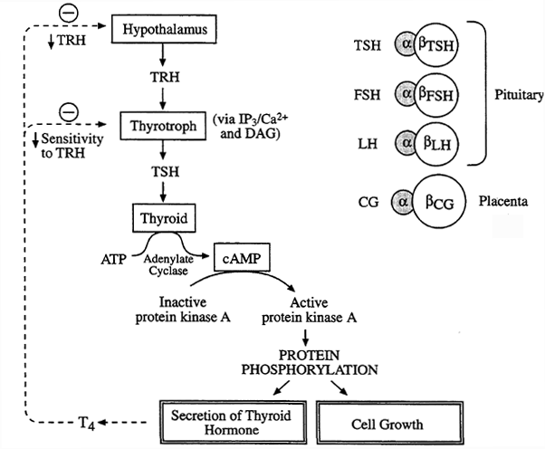
Notes:
http://www2.csudh.edu/nsturm/CHE452/19_Thyroid15.htm

Slide 17
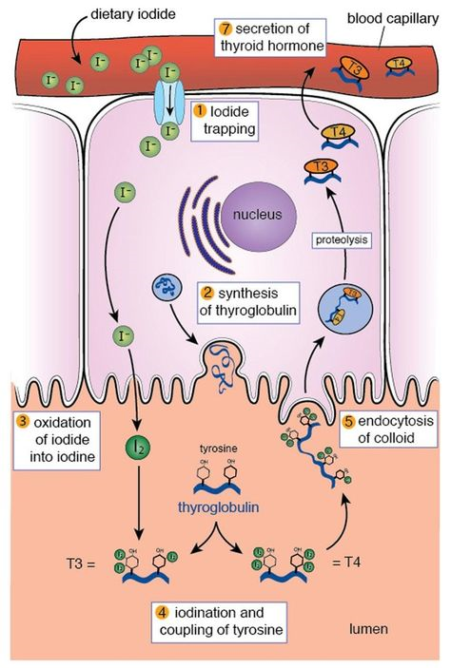
Notes:
Thyroid-stimulating hormone (TSH), also known as thyrotropin, is a glycoprotein hormone secreted by the anterior pituitary gland. TSH is both a tropic and trophic hormone in that it causes its target tissue (thyroid gland) to release hormones and that it promotes the growth of the thyroid gland.
Thyroglobulin (Tg) is a 660 kDa, dimeric protein produced by the follicular cells of the thyroid and used entirely within the thyroid gland. Thyroglobulin protein accounts for approximately half of the protein content of the thyroid gland.[5] Human TG (HTG) is a homodimer of subunits each containing 2768 amino acids as synthesized (a short signal peptide may be removed from the N-terminus in the mature protein).[6]
The protein is a precursor of the thyroid hormones; these are produced when thyroglobulin's tyrosine residues are combined with iodine and the protein is subsequently cleaved. Each thyroglobulin molecule contains approximately 100-120 tyrosine residues, but only a small number (20) of these are subject to iodination by thyroperoxidase in the follicular colloid. Therefore, each Tg molecule forms only approximately 10 thyroid hormone molecules.

Slide 18
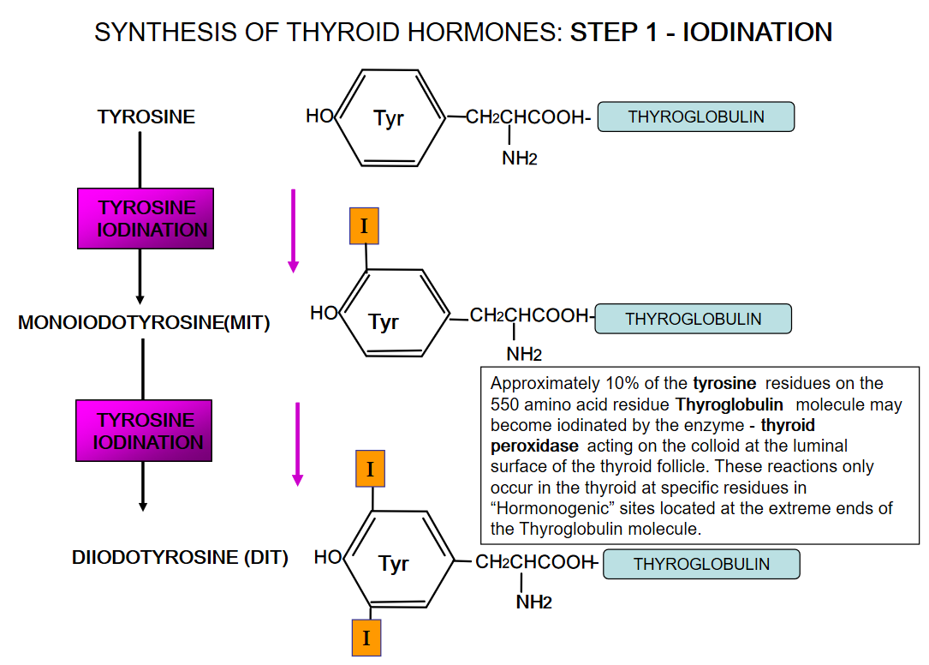

Slide 19
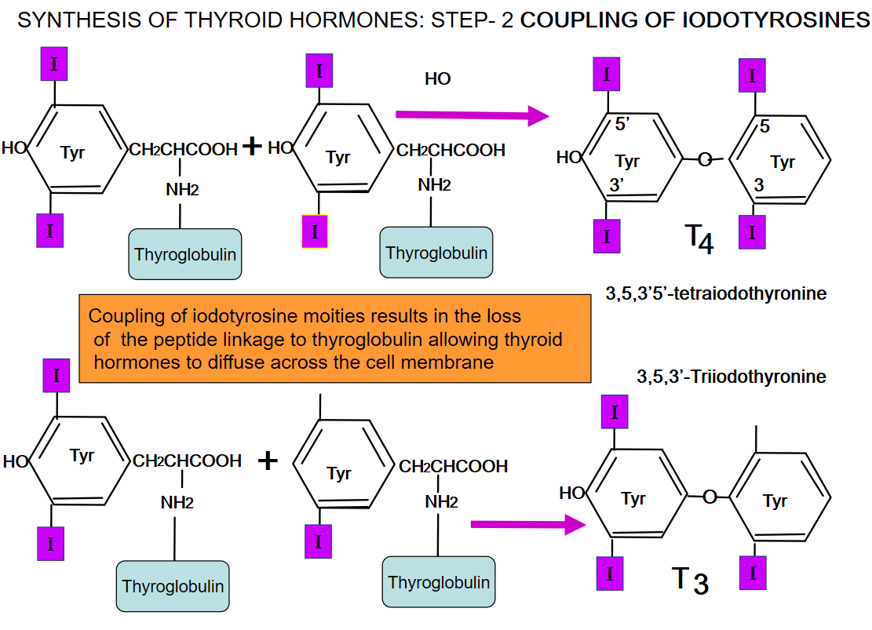

Slide 20
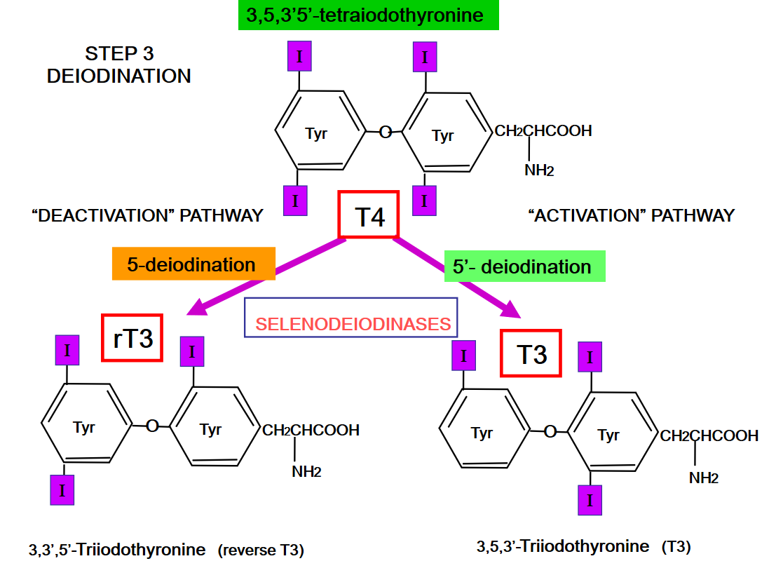
Notes:
https://slideplayer.com/slide/9411700/

Slide 21
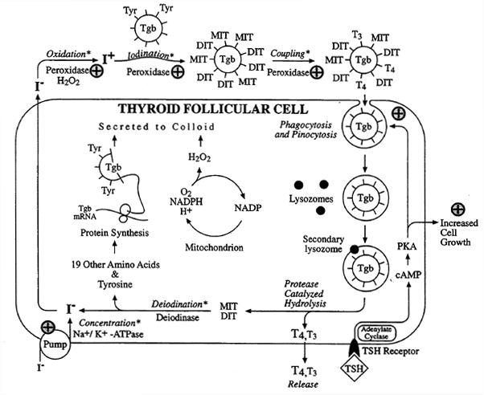
Notes:
Furthermore, TSH also influences the actions of the follicular cells by increasing synthesis and release of the thyroid hormones T4 and T3. This is accomplished by acting upon several different steps in the production of thyroid hormones. First of all, the presence of TSH leads to increased active transport of iodine into the follicular cells from the interstitial fluid and out of the follicular cells into the colloid. Secondly, TSH increases the enzyme activity of thyroid peroxidase to iodinate thyroglobulin. Third, TSH increases iodothyroglobulin transport out of the colloid and back into the follicular cells. Finally, TSH increases the activity of the lysosomal proteases responsible for hydrolysis of iodothyroglobulin to produce T3 and T4. Without TSH binding to the TSH receptors on the follicular cells, thyroid hormone production and release would essentially cease.

Slide 22
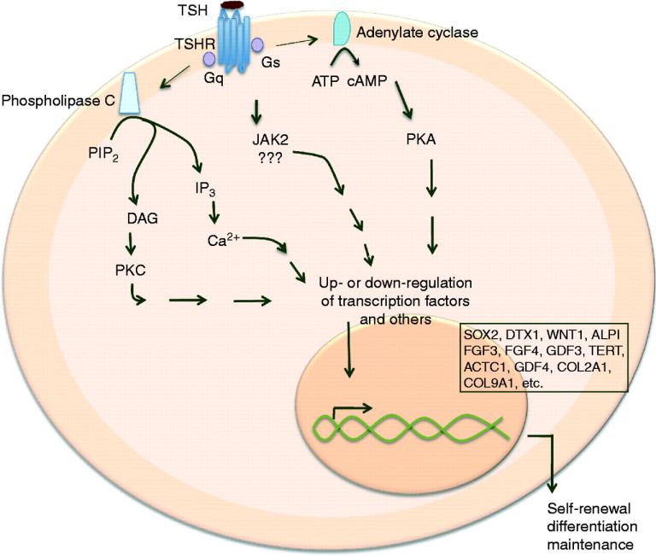
Notes:
The physiological changes in the thyroid follicular cells due to the presence of TSH lead to an increase in the size and changes in the characteristics of the thyroid gland. The overall size of the thyroid is increased by increasing follicular cell division to increase the number of follicular cells and thus increase the number of follicles. Additionally, in the presence of TSH, the follicular cells are larger, more cuboidal or even columnar in shape, but in the absence of TSH, the follicular cells are much smaller, flattened nearly to squamous cells.
Furthermore, TSH also influences the actions of the follicular cells by increasing synthesis and release of the thyroid hormones T4 and T3. This is accomplished by acting upon several different steps in the production of thyroid hormones. First of all, the presence of TSH leads to increased active transport of iodine into the follicular cells from the interstitial fluid and out of the follicular cells into the colloid. Secondly, TSH increases the enzyme activity of thyroid peroxidase to iodinate thyroglobulin. Third, TSH increases iodothyroglobulin transport out of the colloid and back into the follicular cells. Finally, TSH increases the activity of the lysosomal proteases responsible for hydrolysis of iodothyroglobulin to produce T3 and T4. Without TSH binding to the TSH receptors on the follicular cells, thyroid hormone production and release would essentially cease.

Slide 23
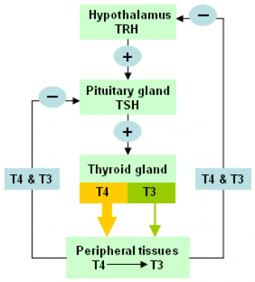

Slide 24
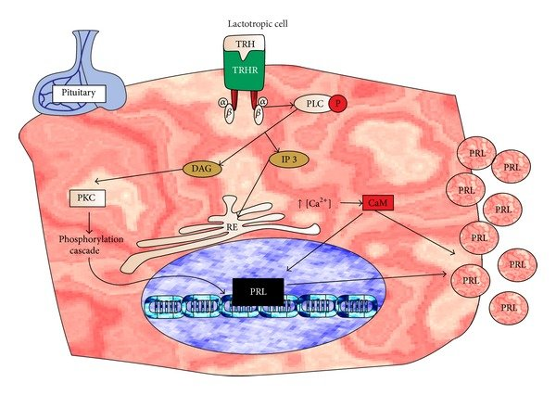
Notes:
Proposed mechanism of action of thyrotropin releasing hormone (TRH). The TRH molecule binds to its receptor in lactotrophic cells of the pituitary gland and stimulates Ca2+/CaM release, which induces the PRL gene expression. Furthermore, the increase in intracellular CA2+/CaM stimulates the release of PRL stored in vesicles. This will increase PRL blood levels and promotes more milk synthesis

Slide 25
HYPOTHALAMIC HORMONE | EFFECTS ON THE ANTERIOR PITUITARY
Thyrotropin-releasing hormone (TRH) | Stimulates release of TSH (thyrotropin) and Prolactin
Corticotropin-releasing hormone (CRH) | Stimulates release of ACTH (corticotropin)
Gonadrotropin-releasing hormone (GnRH) | Stimulates release of FSH and LH (gonadotropins)
Growth hormone-releasing hormone (GHRH) | Stimulates release of growth hormone
Growth hormone-inhibiting hormone (GHIH) | Inhibits release of growth hormone
{Prolactin-inhibiting hormone (PIH) | Stimulates release of prolactin
Prolactin-inhibiting hormone (PIH) | Inhibits release of prolactin

Slide 26
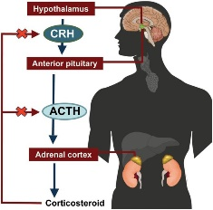
Corticotrophin-releasing hormone:
secreted by the paraventricular nucleus of the hypothalamus
CRH has several important actions
Central driver of the hypothalamic–pituitary–adrenal axis (stress system)
Main function is to stimulate secretion of adrenocorticotropic hormone from pituitary gland
ACTH in turn stimulates adrenal gland to secrete cortisol (stress hormone)
Other CRH functions in brain:
  Suppress appetite
  Increase anxiety
  Improve memory and selective attention
Together, these effects co-ordinate behavior to develop and fine tune the body’s response to a stressful experience
CRH level increased during pregnancy by fetus and placenta
High level of CRH start labor
CRH also made from white blood cells
Where stimulates swelling or tenderness known as inflammation (particularly in gut)
Notes:
Corticotrophin-releasing hormone is secreted by the paraventricular nucleus of the hypothalamus which, among other functions, releases hormones.
Corticotrophin-releasing hormone has several important actions
Its main role in the body is as the central driver of the stress hormone system, known as the hypothalamic–pituitary–adrenal axis.
Corticotrophin-releasing hormone is given this name because it causes release of adrenocorticotropic hormone from the pituitary gland.
Adrenocorticotropic hormone in turn travels in the bloodstream to the adrenal glands, where it causes the secretion of the stress hormone cortisol.
Corticotrophin-releasing hormone also acts on many other areas within the brain where it suppresses appetite, increases anxiety, and improves memory and selective attention. Together, these effects co-ordinate behaviour to develop and fine tune the body’s response to a stressful experience.
Corticotrophin-releasing hormone is also produced throughout pregnancy in increasing amounts by the foetus and the placenta, with the effects of increasing cortisol. Ultimately, it is the high levels of corticotrophin-releasing hormone that, along with other hormones, are thought to start labour.
Finally, in smaller quantities, corticotrophin-releasing hormone is also made by certain white blood cells, where it stimulates swelling or tenderness known as inflammation, particularly of the gut.

Slide 27
CRH controlling:
By circadian rhythm (max at 8 am and min during night)
Increased by stress, infection and sport activities
CRH high level increase cortisol and it causes increasing available energy to deal with stress
Long term stress suppress hypothalamic–pituitary–adrenal axis
Cortisol has feed back suppression effect on CRH
Different levels of CRH causes some disease:
  Inflammation particularly in skin, stomach and joints
  Low levels of CRH have been observed in Alzheimer patients
  Low levels of CRH cause chronic fatigue syndrome
  Low levels of CRH during pregnancy can leads to abortion
Human CRH: 41 amino acid peptide
Notes:
CRH controlling:
توسط ریتم 24 ساعته شبانه روزی کنترل میشود، 8 صبح حداکثر مقدار و در طول شب کمترین مقدار را دارد. توسط استرس، عفونت و فعالیت ورزشی افزایش میابد.
افزایش CRH باعث افزایش هورمونهای کورتیزولی استرس شده و باعث در دسترس قرار گرفتن انرژی برای مواجهه با شرایط تنش میشود.
افزایش دوره استرس باعث مهار محور هیپوتالاموسی-هیپوفیزی میشود به این دلیل که سطح بالای کورتیزول اثر مهاری بر روی تولید CRH دارد.
افزایش سطح CRH باعث ایجاد برخی بیماریها میشود.
به دلیل مهار اشتها و تحریک نگرانی سطح بالای CRH باعث ایجاد مشکلات عصبی مانند افسردگی، پریشانی، اختلال خواب و بی اشتهایی عصبی شود.
سطح بالای CRH همچنین باعث ایجاد التهاب شود، خصوصا در مفاصل، پوست و معده.
سطح پایین CRH در بیماران مبتلا به آلزایمر دیده میشود.
همچنین کاهش سطح CRH باعث ایجاد سندرم خستگی مزمن میشود افراد مبتلا داراری مشکلاتی در خواب، حافظه و تمرکز هستند.
کاهش تولید CRH توسط جنین و جفت در دوران بارداری میتواند باعث سقط جنین شود.
Human CRH: 41-amino acid peptide

Slide 28
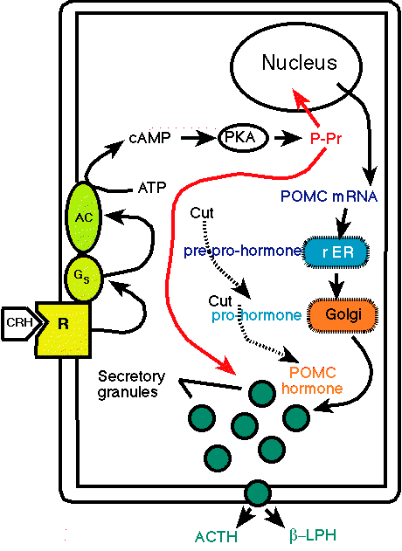
Notes:
Human CRH: 41-amino acid peptide
Stimulates ACTH and b-endorphins pituitary release.
Is produced from POMC
R ER (rough endoplasmic reticulum)
https://www.pharmacology2000.com/nursing_pharmacology/Hypothalamic/pituitary3.htm

Slide 29
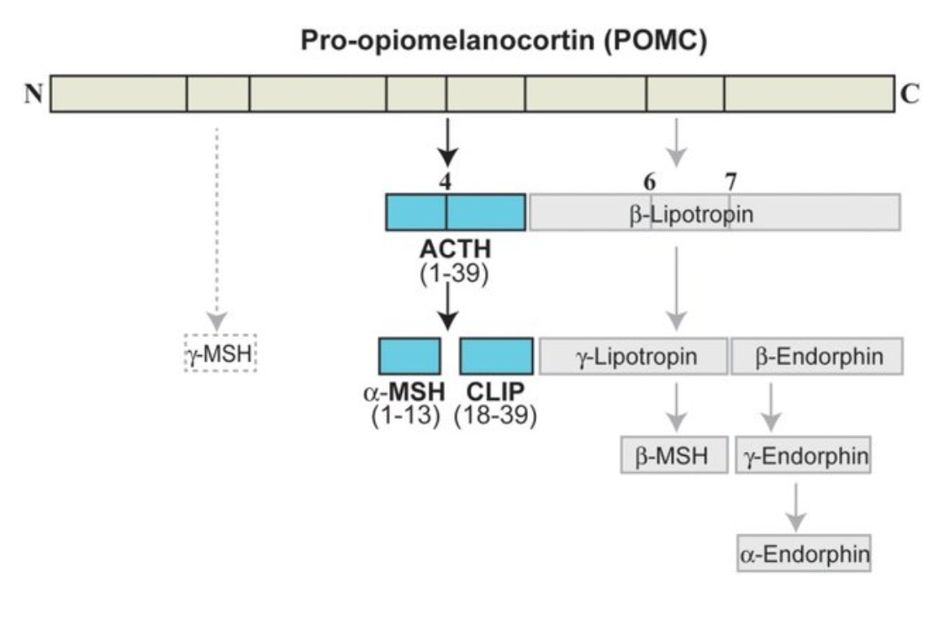
Notes:
Adrenocorticotropic hormone, as its name implies, stimulates the adrenal cortex. More specifically, it stimulates secretion of glucocorticoids such as cortisol, and has little control over secretion of aldosterone, the other major steroid hormone from the adrenal cortex.
Within the pituitary gland, ACTH is produced in a process that also generates several other hormones. A large precursor protein named proopiomelanocortin (POMC, "Big Mama") is synthesized and proteolytically chopped into several fragments as depicted below. Not all of the cleavages occur in all species and some occur only in the intermediate lobe of the pituitary.
The major attributes of the hormones other than ACTH that are produced in this process are summarized as follows:
Lipotropin: Originally described as having weak lipolytic effects, its major importance is as the precursor to beta-endorphin.
Beta-endorphin and Met-enkephalin: Opioid peptides with pain-alleviation and euphoric effects.
Melanocyte-stimulating hormone (MSH): Known to control melanin pigmentation in the skin of most vertebrates
http://www.vivo.colostate.edu/hbooks/pathphys/endocrine/hypopit/acth.html

Slide 30
Notes:
سه گروه اصلی pomc
Acth که میتواند alpha-msh و پپتید شبه کورتیکوتروپین لوب میانی clip را بسازد Corticotropin-like Intermediate Peptide (CLIP)
Beta-lipoprotein (b-lph) که میتواند gama-lph و beta-msh و بتا اندورفین را بسازد
و بخش آمینی آن که gama msh دارد.

Slide 31
Proopiomelanocortin (POMC) is a precursor polypeptide with 266 amino acid residues (“big mama”)
POMC is synthesized in the pituitary from the 285-amino-acid-long polypeptide precursor pre-proopiomelanocortin (pre-POMC), by the removal of a 44-amino-acid-long signal peptide sequence
POMC is cleaved to give rise to multiple peptide hormones
POMC gene expressed in anterior and middle pituitary (also has been observed in brain, digestive and reproductive system, lymphocytes and placenta
Its processing is different in different cells (middle pituitary is inactive in human except in fetus and late pregnancy)
POMC processing occurs in basic amino acid locations by Trypsin like enzymes
Notes:
Each of these peptides is packaged in large dense-core vesicles that are released from the cells by exocytosis in response to appropriate stimulation:
پردازش در بافتهای محیطی مثل پردازش در هیپوفیز میانی
سه گروه اصلی pomc
Acth که میتواند alpha-msh و پپتید شبه کورتیکوتروپین لوب میانی clip را بسازد Corticotropin-like Intermediate Peptide (CLIP)
Beta-lipoprotein (b-lph) که میتواند gama-lph و beta-msh و بتا اندورفین را بسازد
و بخش آمینی آن که gama msh دارد.
پردازش pomc عمدتا در محلهای اسیدهای آمینه بازی و توسط آنزیمهای شبه تریپسینی انجام میشود.
Acth
زنجیره ای پروتئینی از 39 اسید امینه است که رشد و عملکرد قشر فوق کلیه را تحت تاثیر قرار میدهد
24 اسید امینه اول بخش آمینی برای فعالیت بیولوژیک ضروری است و در گونه های مختلف حفظ شده است
سر کربوکسی متغیر بوده و عامل ایجاد پاسخ ایمنی است
این هورمون باعث افزایش تبدیل کلسترول به پرگنالونون میشود
پرگنالونون پیشساز همه استروئیدهای فوق کلیه است
در شرایط فیزیولوژیک acth در تنظیم مینرالوکورتیکوئیدها و هورمونهای جنسی نقش کمی دارند.
Acth دارای اثر تروفیک برای قشر فوق کلیه میباشد
این هورمون اثر خود را از طریق camp ایفا میکند
کلسیم نیز در اثرات این هورمون نقش دارد
تولید بیش از حد acth باعث ایجاد سندرم کوشینگ میشود
به علت فعالیت شبه msh ضعیف acth یا تولید توام alpha or beta msh تسرگی پوست مشاهده میشود.
بتا لیپوپروتئین
توالی 91 اسید آمینه ای از سر کربوکسی pomc
دارای توالی های beta-msh and gama-lph و مت انکفالین و بتا اندورفین است
Beta-lph فقط در هیپوفیز دیده میشود زیرا در بافتهای دیگر سریعا به gama-lph و بتا اندورفین تبدیل میشود.
Beta-lph باعث تجزیه چربی و آزادی اسیدهای چرب میشود
بتا اندورفین از 31 اسید آمینه انتهایی beta-lph ایجاد میشود
اندورفین های آلفا و گاما از اندورفین بتا ایجاد میشود
این پپتیدها در هیپوفیز به فرم استیله بوده و غیر فعال هستند ولی در دستگاه عصبی مرکزی به شکل یک میانجی عصبی تغییر میکنند
اندورفینها در cns به گیرنده افیونها قابلیت اتصال دارند و احتمالا در کنترل درد ایفای نقش میکنند
توالی انکفالین در pomc وجود دارد ولی قبل از آن اسید آمینه بازی وجود ندارد که بریده و آزاد شود
هورمون محرک ملانوسیت msh
عمل تیره کردن پوست و پیگمنتاسیون را انجام میدهد
سه نوع msh در pomc وجود دارد شامل آلفا، بتا و گاما
در بیماران مبتلا به تولید ناکافی گلوکوکورتیکوئیدها (بیماری آدیسون) فعالیت MSH پلاسما افزایش میابد و هایپرپیگمناسیون ایجاد میشود.
این علایم میتواند مربوط به ACTH نیز باشد چون میتواند فعالید MSH را تا حدودی انجام دهد ولی به احتمال بیشتر ناشی از اثرات بتا و گاما لیپوپروتئین باشد که مثل ACTH فعالیت MSH را از خود نشان میدهند

Slide 32
ACTH:
39 AA peptide with tropic and trophic effect on adrenal cortex
24 amine terminal necessary for biological effect and protect among different species
Carboxyl terminal varied in different species
ACTH increases Cholesterol conversion to Pregnenolone in adrenal cortex
Pregnenolone is precursor to produce all of the adrenal cortex steroid hormones
ACTH has minor regulatory effect on mineralocorticoids and sex hormones production
cAMP as secondary messenger for ACTH
Ca ion also cooperate with ACTH
High level of ACTH causes Cushing syndrome
Notes:
Acth
سر کربوکسی متغیر بوده و عامل ایجاد پاسخ ایمنی است
تولید بیش از حد acth باعث ایجاد سندرم کوشینگ میشود
به علت فعالیت شبه msh ضعیف acth یا تولید توام alpha or beta msh تسرگی پوست مشاهده میشود.

Slide 33
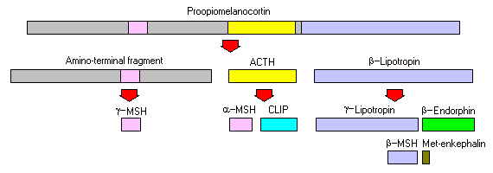
β-LPH:
91 AA from POMC carboxyl terminal
ɣ-LPH, β-MSH, β-endorphin and Met-encephalin sequences in β-LPH
β-LPH presents only in pituitary
It is converted to ɣ-LPH and β-endorphin in other tissues immediately
β-LPH causes fat decomposition and releasing fatty acids
β-endorphin (31 AA of C-terminal of β-LPH)
Gamma and alpha endorphin produced from β-endorphin
Endorphins present in acetylated (inactive form) in pituitary
De-acetylated (activated) in CNS and play as Neurotransmitter
Encephalin sequence present in POMC
Notes:
اندورفینها در cns به گیرنده افیونها قابلیت اتصال دارند و احتمالا در کنترل درد ایفای نقش میکنند
توالی انکفالین در pomc وجود دارد ولی قبل از آن اسید آمینه بازی وجود ندارد که بریده و آزاد شود

Slide 34
MSH:
Melanocyte stimulating hormone
Three type of MSH in POMC (alpha, beta and gamma)
Addison disease (Inadequate production of glucocorticoids and high activity of MSH resulted in skin hyperpigmentation)
This can be seen in high levels of ACTH and beta and gamma lipoprotein
Notes:
هورمون محرک ملانوسیت msh
عمل تیره کردن پوست و پیگمنتاسیون را انجام میدهد
سه نوع msh در pomc وجود دارد شامل آلفا، بتا و گاما
در بیماران مبتلا به تولید ناکافی گلوکوکورتیکوئیدها (بیماری آدیسون) فعالیت MSH پلاسما افزایش میابد و هایپرپیگمناسیون ایجاد میشود.
این علایم میتواند مربوط به ACTH نیز باشد چون میتواند فعالید MSH را تا حدودی انجام دهد ولی به احتمال بیشتر ناشی از اثرات بتا و گاما لیپوپروتئین باشد که مثل ACTH فعالیت MSH را از خود نشان میدهند

Slide 35
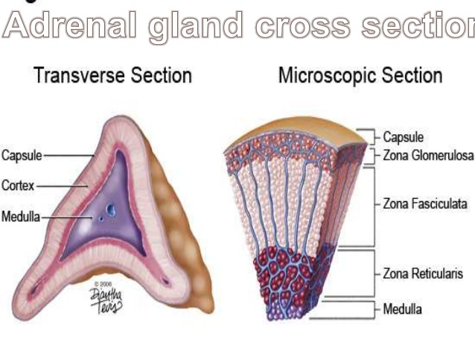
Notes:
The mammalian adrenal cortex is composed of cells that are segregated into separate zones with distinct functions, the zona glomerulosa (ZG), zona fasciculata (ZF) and zona reticularis (ZR), and distinct sets of steroidogenic genes are expressed in each zone.
GC is mainly produced in the ZF, where the ACTH receptor (ACTHR; melanocortin receptor 2, MC2R) is also highly expressed.

Slide 36
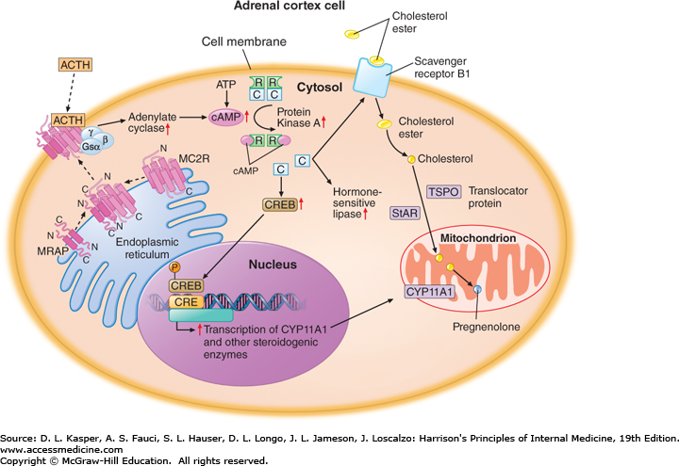
Notes:
During activation of the HPA axis, ACTH binds to the ACTHR, activates heterotrimeric Gs protein, and subsequently stimulates adenylyl cyclase
Intracellular cAMP then activates protein kinase A (PKA) nuclear transcription factors, such as cAMP response element (CRE) binding protein (CREB) and CRE modulator (CREM). These transcription factors modulate the expression of genes involved in adrenal GC biosynthesis by binding to the CRE residing in the promoter regions of those genes Various sets of steroidogenic genes are known to be involved in adrenal GC biosynthesis.
First, cholesterol has to be transferred from the cytosol to the inner mitochondrial membrane, where it can be converted to pregnenolone, a common steroid precursor.
Steroidogenic acute regulatory protein (StAR), the expression of which rapidly responds to hormonal stimulation, mediates the delivery of cholesterol to the site of its first enzymatic conversion of cholesterol to pregnenolone by CYP11A1 (Cytochrome P450 Family 11 Subfamily A Member 1)(cholesterol side chain cleavage monooxygenase).

Slide 37
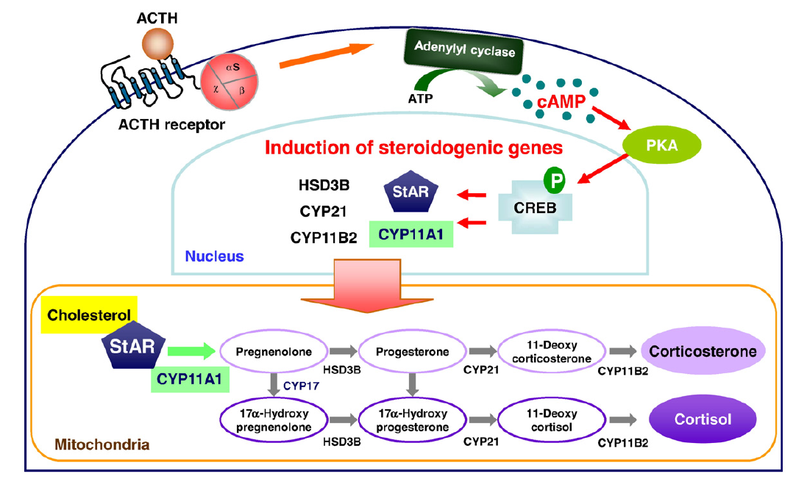
Notes:
pregnenolone is then subjected to the sequential actions of several steroid hydrogenases (cytochrome P450 and heme-containing proteins) and HSD3Bs (3β-hydroxysteroid dehydrogenases), ultimately leading to GC production.
CYP17 (17α-hydroxylase) is present only in cortisol-producing species such as humans but not in corticosterone-producing species such as rats and mice.
CYP21 enzymatic activity is done in SER.

Slide 38
HYPOTHALAMIC HORMONE | EFFECTS ON THE ANTERIOR PITUITARY
Thyrotropin-releasing hormone (TRH) | Stimulates release of TSH (thyrotropin) and Prolactin
Corticotropin-releasing hormone (CRH) | Stimulates release of ACTH (corticotropin)
Gonadrotropin-releasing hormone (GnRH) | Stimulates release of FSH and LH (gonadotropins)
Growth hormone-releasing hormone (GHRH) | Stimulates release of growth hormone
Growth hormone-inhibiting hormone (GHIH) | Inhibits release of growth hormone
{Prolactin-inhibiting hormone (PIH) | Stimulates release of prolactin
Prolactin-inhibiting hormone (PIH) | Inhibits release of prolactin

Slide 39
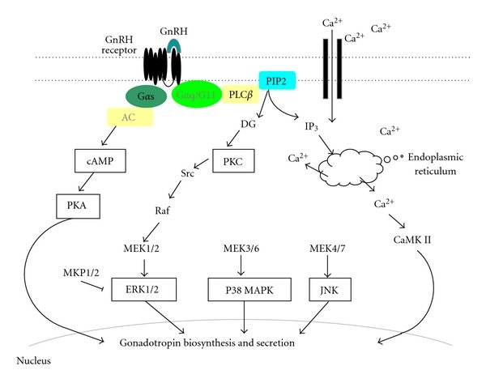
Notes:
GnRH is a peptide consists of 10 amino acids
The initial phase of GnRH action involves Gq-protein-mediated stimulation of phospholipase Cβ (PLCβ), leading to the formation of 1,4,5-triphosphate (IP3) and diacylglycerol (DG). IP3 induces the release of intracellular calcium from endoplasmic reticulum, and DG activates protein kinase C (PKC), which ultimately activates extracellular signal-regulated kinase (ERK). P38 MAPK, c-Jun N-terminal kinase (JNK), and calcium-calmodulin kinase II (CaMK II) are also activated by GnRH. Not predominant, but GnRH also couples to Gs protein which are linked with adenylate cyclase and induces rapid cAMP production, which ultimately activates protein kinase A (PKA). MAP kinase phosphatase 1/2 (MKP1/2) inactivates ERK by dephosphorylation.
https://www.researchgate.net/publication/221738700_Extracellular_Signal-Regulated_Kinase_ERK_Activation_and_Mitogen-Activated_Protein_Kinase_Phosphatase_1_Induction_by_Pulsatile_Gonadotropin-Releasing_Hormone_in_Pituitary_Gonadotrophs/figures?lo=1

Slide 40
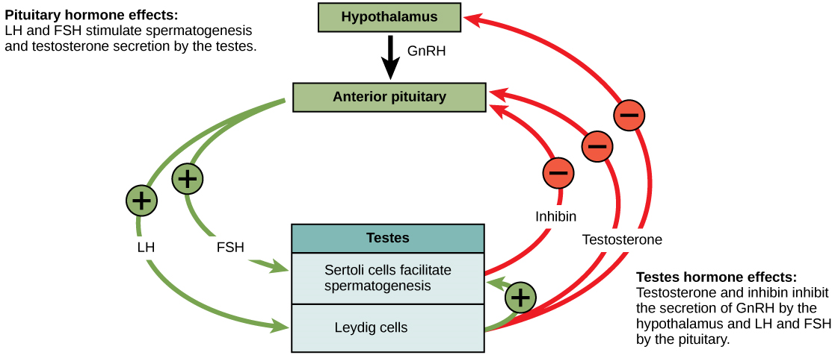
Notes:
At the onset of puberty, the hypothalamus causes the release of FSH and LH into the male system for the first time. FSH enters the testes and stimulates the Sertoli cells to begin facilitating spermatogenesis using negative feedback, as illustrated in
Figure 24.14. LH also enters the testes and stimulates the interstitial cells of Leydig to make and release testosterone into the testes and the blood.
Testosterone, the hormone responsible for the secondary sexual characteristics that develop in the male during adolescence, stimulates spermatogenesis. These secondary sex characteristics include a deepening of the voice, the growth of facial, axillary, and pubic hair, and the beginnings of the sex drive
A negative feedback system occurs in the male with rising levels of testosterone acting on the hypothalamus and anterior pituitary to inhibit the release of GnRH, FSH, and LH. The Sertoli cells produce the hormone inhibin, which is released into the blood when the sperm count is too high. This inhibits the release of GnRH and FSH, which will cause spermatogenesis to slow down. If the sperm count reaches 20 million/ml, the Sertoli cells cease the release of inhibin, and the sperm count increases.

Slide 41
The control of reproduction in females is more complex
Estrogen (estradiol) is the reproductive hormone in females that assists in endometrial regrowth, ovulation, and calcium absorption; it is also responsible for the secondary sexual characteristics of females.
Progesterone assists in endometrial re-growth and inhibition of FSH and LH release.
In females, FSH stimulates development of egg cells, called ova, which develop in structures called follicles.
Follicle cells produce the hormone inhibin, which inhibits FSH production.
LH also plays a role in the development of ova, induction of ovulation, and stimulation of estradiol and progesterone production by the ovaries
Estradiol and progesterone are steroid hormones that prepare the body for pregnancy.
Estradiol produces secondary sex characteristics in females, while both estradiol and progesterone regulate the menstrual cycle.
Notes:
. As with the male, the anterior pituitary hormones cause the release of the hormones FSH and LH. In addition, estrogens and progesterone are released from the developing follicles.

Slide 42
The ovarian cycle governs the preparation of endocrine tissues and release of eggs
menstrual cycle governs the preparation and maintenance of the uterine lining
These cycles occur concurrently and are coordinated over a 22–32 day cycle, with an average length of 28 days

Slide 43
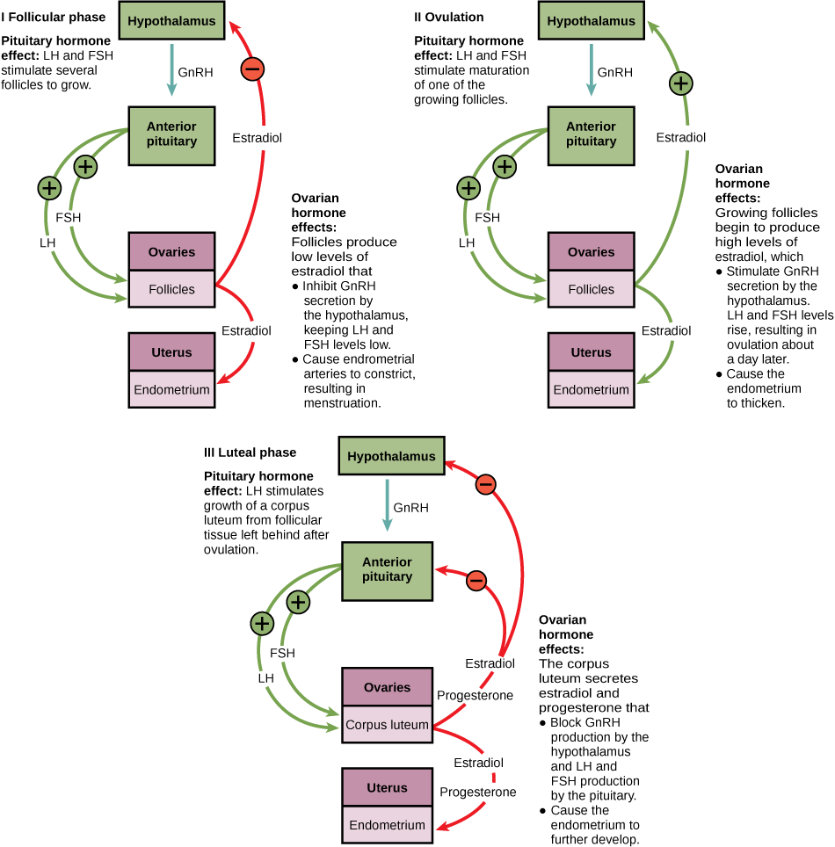
Notes:
The first half of the ovarian cycle is the follicular phase shown in Figure 24.15. Slowly rising levels of FSH and LH cause the growth of follicles on the surface of the ovary. This process prepares the egg for ovulation. As the follicles grow, they begin releasing estrogens and a low level of progesterone. Progesterone maintains the endometrium to help ensure pregnancy. After about five days, estrogen levels rise and the menstrual cycle enters the proliferative phase. The endometrium begins to regrow, replacing the blood vessels and glands that deteriorated during the end of the last cycle.
Just prior to the middle of the cycle (approximately day 14), the high level of estrogen causes FSH and especially LH to rise rapidly, then fall. The spike in LH causes ovulation: the most mature follicle, like that shown in Figure 24.16, ruptures and releases its egg. The follicles that did not rupture degenerate and their eggs are lost. The level of estrogen decreases when the extra follicles degenerate.

Slide 44
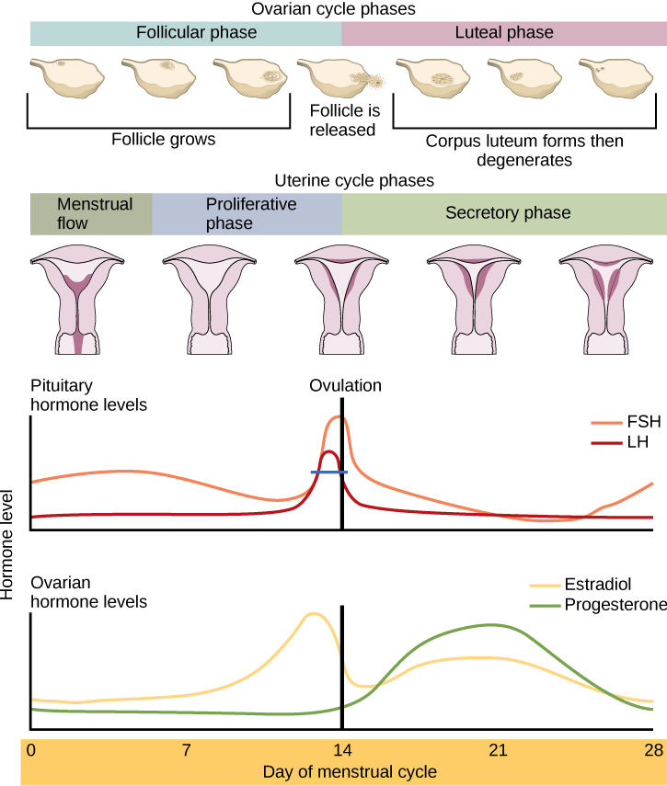
Notes:
Following ovulation, the ovarian cycle enters its luteal phase, illustrated in Figure 24.15 and the menstrual cycle enters its secretory phase, both of which run from about day 15 to 28. The luteal and secretory phases refer to changes in the ruptured follicle. The cells in the follicle undergo physical changes and produce a structure called a corpus luteum. The corpus luteum produces estrogen and progesterone. The progesterone facilitates the regrowth of the uterine lining and inhibits the release of further FSH and LH. The uterus is being prepared to accept a fertilized egg, should it occur during this cycle. The inhibition of FSH and LH prevents any further eggs and follicles from developing, while the progesterone is elevated. The level of estrogen produced by the corpus luteum increases to a steady level for the next few days.
If no fertilized egg is implanted into the uterus, the corpus luteum degenerates and the levels of estrogen and progesterone decrease. The endometrium begins to degenerate as the progesterone levels drop, initiating the next menstrual cycle. The decrease in progesterone also allows the hypothalamus to send GnRH to the anterior pituitary, releasing FSH and LH and starting the cycles again. Figure 24.17 visually compares the ovarian and uterine cycles as well as the commensurate hormone levels.

Slide 45
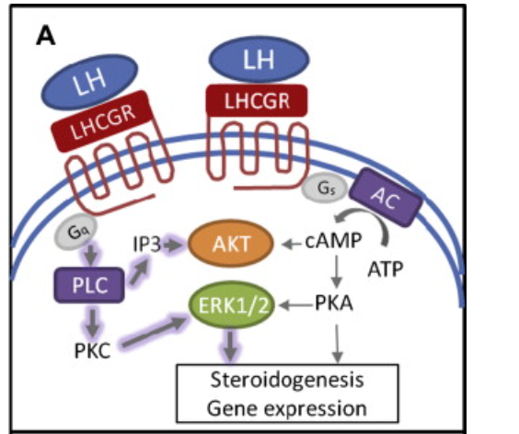
Notes:
LH binding (A) has a greater impact (thicker arrow) on AKT and extracellular signal-regulated protein kinase (ERK1/2) phosphorylation

Slide 46
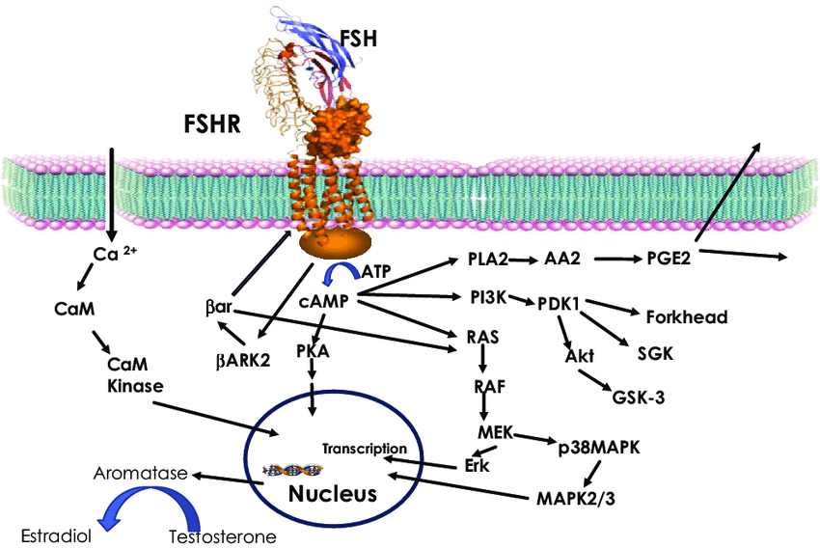
Notes:
FSH signaling. Activation of FSHR by FSH leads to increase in intracellular cAMP through Gs-adenylate cyclase. Increased cAMP leads to PKA activation, which regulate expression of several genes through phosphorylation of transcription factors like CREBP. FSH also causes increase in Ca 2+ by depolarization of Ca channels. Increased Ca 2+ can upregulate calmodulin kinase leading to modulation of downstream effectors. In addition to cAMP, FSH has also been shown to modulate PLA, Erk, p38 MAPK, and PI3Kinase pathways. Activated FSHR is phosphorylated by BARK, which in turn recruits β-arrestin to the receptor and lead to down regulation of FSHR, in addition, β-arrestin independently can activate Erk pathway

Slide 47
HYPOTHALAMIC HORMONE | EFFECTS ON THE ANTERIOR PITUITARY
Thyrotropin-releasing hormone (TRH) | Stimulates release of TSH (thyrotropin) and Prolactin
Corticotropin-releasing hormone (CRH) | Stimulates release of ACTH (corticotropin)
Gonadrotropin-releasing hormone (GnRH) | Stimulates release of FSH and LH (gonadotropins)
Growth hormone-releasing hormone (GHRH) | Stimulates release of growth hormone
Growth hormone-inhibiting hormone (GHIH) | Inhibits release of growth hormone
{Prolactin-inhibiting hormone (PIH) | Stimulates release of prolactin
Prolactin-inhibiting hormone (PIH) | Inhibits release of prolactin

Slide 48
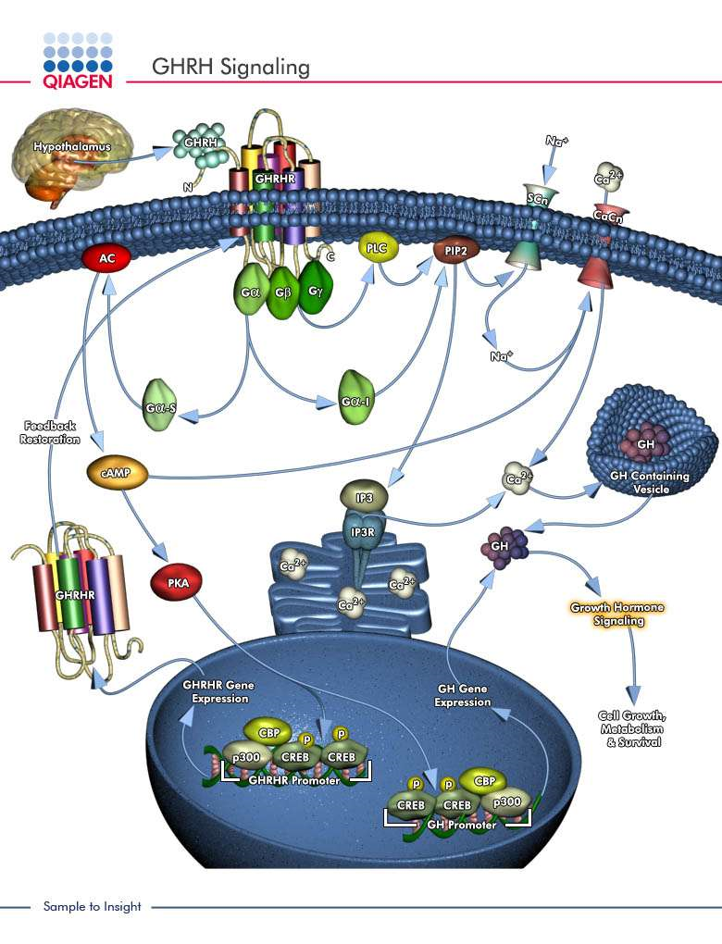
Notes:
Growth hormone is a 44 AA peptide
https://www.qiagen.com/mx/shop/genes-and-pathways/pathway-details/?pwid=199

Slide 49
What is growth hormone-releasing hormone?
The main role of GHRH is to stimulate the pituitary gland produce and release growth hormone
It virtually controls metabolism and growth
Growth hormone stimulates production of insulin-like growth factor1 in the liver and other organs
Growth hormone-releasing hormone also affects sleep, food intake and memory

Slide 50
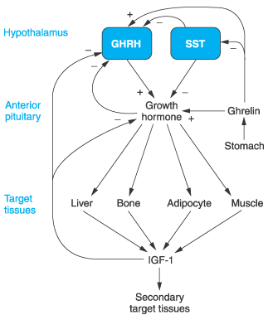
Notes:
In order to maintain a normal balanced hormone production, growth hormone-releasing hormone, somatostatin, growth hormone and insulin-like growth factor 1 levels are regulated by each other. The consequence of growth hormone-releasing hormone action is an increase in the circulating levels of growth hormone and insulin-like growth factor 1 which, in turn, act back on the hypothalamus to prevent growth hormone-releasing hormone production and to stimulate somatostatin secretion. Somatostatin then prevents the release of growth hormone from the pituitary gland and growth hormone-releasing hormone production by the hypothalamus, therefore acting as a powerful suppressor of growth hormone secretion.
Many other factors and physiological conditions such as sleep, stress, exercise and food intake also affect the hypothalamic release of growth hormone-releasing hormone and somatostatin.

Slide 51
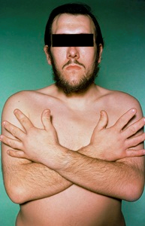
Too much GHRH production may be caused by hypothalamic tumors or by tumors located in other parts of the body (ectopic tumors)
High levels of GHRH causes rise in GH levels in the bloodstream and, in many cases, enlargement of the pituitary gland
In adults, excessive GH for a long period of time produces a condition known as Acromegaly
These patients also have organ enlargement and serious functional disorders such as high blood pressure, diabetes and heart disease
High levels of GH leads to Gigantism
In most cases, growth hormone overproduction is caused by pituitary tumors that produce growth hormone; only in very rare occasions is excess growth hormone caused by overproduction of GHRH

Slide 52
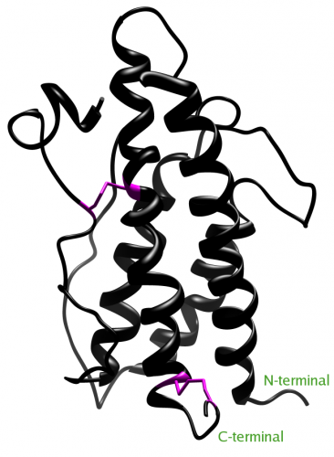
Growth Hormone
191 amino acids long
Protein structure
4 helices that help it bind its receptor
2 strong sulfide bonds hold the structure together
primary hormonal control is via positive regulation by GHRH and negative regulation by somatostatin
males have pulsatile secretion but females exhibit a continuous secretion
The most characterized role is in stimulating longitudinal bone growth
GH also impacts cell growth, differentiation, and metabolism, through coordinated actions on different tissues, including liver, adipose tissue, skeletal muscle, and bone

Slide 53
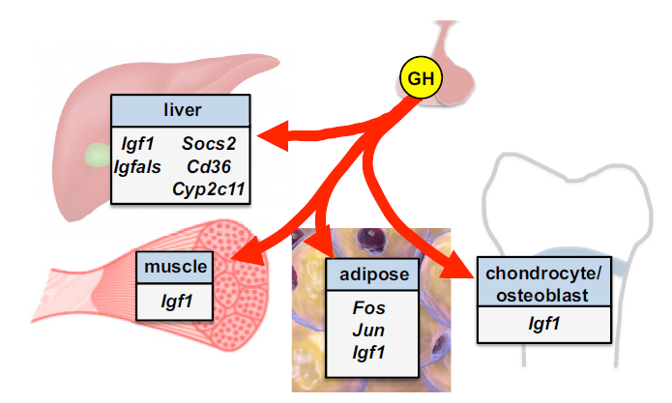
Notes:
Liver is a major target organ for the action of GH, in large part because it is the major source of circulating IGF-1
GH acts as a counterregulatory hormone to increase glucose levels in the setting of hypoglycemia by increasing hepatic glucose production via both glycogenolysis and gluconeogenesis
GH also effects lipid metabolism in liver through multiple mechanisms.
A primary role of GH on adipose tissue is in stimulating lipolysis, with an acute rise in free fatty acids regarded as a standard for assessing an appropriate in vivo GH effect
GH and IGF-1 together promote skeletal muscle growth, maintenance, repair, and regeneration
Aside from the actions of the GH-IGF-1 axis at the growth plate to promote longitudinal growth, the axis also functions to regulate skeletal development and mineral acquisition

Slide 54
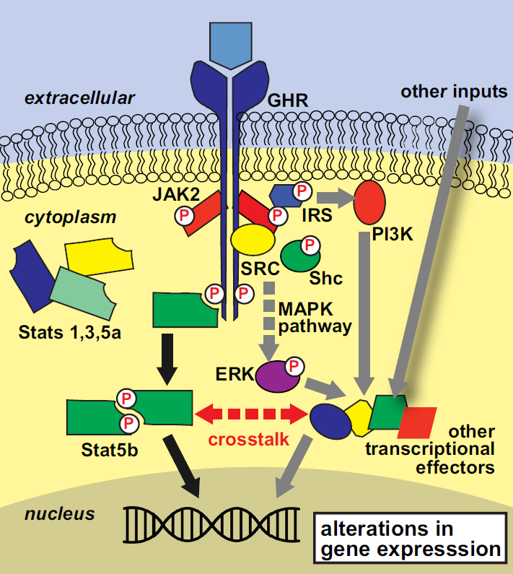
Notes:
GHRis a member of the class I cytokine receptor superfamily with a single transmembrane domain. It exists as a preformed homodimer in its inactive state and subsequently undergoes conformational change upon binding of a single GH molecule to the high-affinity sites of each of the 2 GHR molecules. GHR itself has no intrinsic tyrosine kinase activity; however, the tyrosine kinase JAK2 is associated with the Box1 sequence in the cytoplasmic domain of the receptor and transphosphorylates following GH binding (55). Activated JAK2 then phosphorylates other tyrosine residues of the cytoplasmic domain of GHR. These phospho-tyrosine residues function as docking sites for intracellular proteins with Src homology 2 (SH2) or phospho-tyrosine binding domains and these proteins become targets for phosphorylation by JAK2
The best characterized targets of JAK phosphorylation are members of the Stat family of transcription factors . All Stat family members share a similar organization that includes a SH2 domain and a conserved tyrosine residue near the C terminus. Upon recruitment to the GHR-JAK2 complex, the Stat proteins are phosphorylated at the conserved tyrosine residue, dissociate from the membrane-bound complex, and form dimers with other phosphorylated Stat proteins via reciprocal interactions of SH2 domains and phospho-tyrosine residues. They then translocate to the nucleus where they bind to specific recognition sequences and influence gene transcription. Stats 1, 3, 5a, and 5b are all phosphorylated with GH signaling, and Stat5b is regarded as the major
mediator of GH action.
Two well-known signal transduction pathways that also act downstream of GH are the MAPK and the phosphatidylinositol 3-kinase (PI3K) pathways. Conventional models hold that these pathways are activated by tyrosine phosphorylation of a signaling molecule by JAK2. With the MAPK pathway, the adaptor protein Shc is phosphorylated by JAK2 and then acts via Grb2 and SOS to signal a phosphorylation cascade through Ras, Raf, MAPK kinase, and ERK (67). The PI3K pathway is activated through phosphorylation of insulin receptor substrate 1 (68), thus using the same effectors as insulinand IGF-1 in signal transduction.
Noncanonical signaling independent of JAK2 through SRC (yellow) leading to activation of ERK has also been demonstrated.

Slide 55
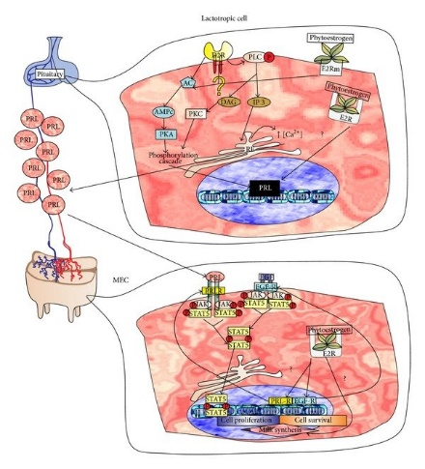
Notes:
https://www.researchgate.net/publication/266151586_Pharmacological_Overview_of_Galactogogues/figures?lo=1
هورمون پرولاکتین از سلولهای لاکتوتروپ هیپوفیز قدامی ترشح میشود. تعداد و اندازه این سلولها هنگام بارداری افزایش میابد
گیرنده هورمون پرولاکتین تقریبا هم اندازه گیرنده هورمون رشد میباشد و مکانیسم انتقال پیام تقریبا مشابه مکانیسم انتقال پیام در گیرنده هورمون رشد میباشد.
این هورمون در شیردهی (شروع و حفظ آن) نقش دارد. منتهی باید ابتدا بافتپستانی توسط هورمونهای جنسی زنانه آماده شده باشد تا غلظتهای فیزیولوژیک پرولاکتین کارساز باشد.

Slide 56
Posterior Pituitary
Comprised of the endings of axons from cell bodies in the hypothalamus (supraoptic and paraventricular)
Axons pass from the hypothalamus to the posterior pituitary via the hypothalamo hypophysial tract
Posterior pituitary hormones are synthesized in the cell bodies of neurons in the supraoptic (ADH) and paraventricular nuclei(oxytocin)
Notes:
The paraventricular nucleus (PVN, PVA, or PVH) is a nucleus in the hypothalamus.^{[1]} It is a group of neurons that can be activated by physiological changes including stress. Many PVN neurons project directly to the posterior pituitary where they release oxytocin into the general circulation. While the supraoptic nucleus releases vasopressin. Both the PVN and the supraoptic nucleus do produce small amounts of the other hormone, ADH and Oxytocin respectively. Other PVN neurons control various anterior pituitary functions.
هورمونهای هیپوفیز خلفی پس از ترشح در هسته های خاص عصبی از طریق پروتئینهای خاص حامل به نام نوروفیزین های یک و دو به ترتیب برای اکسی توسین و وازوپرسین به هیپوفیز خلفی منتقل میشوند.

Slide 57
Posterior Pituitary
Hormones synthesized in the hypothalamus are transported down the axons to the endings in the posterior pituitary
Hormones are stored in vesicles in the posterior pituitary until release into the circulation
Principal Hormones: Vasopressin & Oxytocin
Notes:
این هورمونها از طریق هیپوفیز خلفی به جریان خون آزاد میشوند. در جریان خون به صورت مستقل از پروتئینهای حامل میباشند. به همین دلیل نیمه عمر پایینی دارند.
ساختار هر دو پروتئین شبیه به هم میباشد و به صورت پپتیدی میباشند.هر یک از اینها یک نانوپپتید میباشدکه داراری دو ریشه سیستئین در موقعیتهای یک و شش میباشند که که توسط پیوند دی سولفیدی به یکدیگر متصل میباشند.
با توجه به شباهت ساختاری که دارند تا حدودی عملکرد یکدیگر را تقلید میکنند.
محل متابولیزه شدن این هورمونها عمدتا در کبد میباشد.

Slide 58
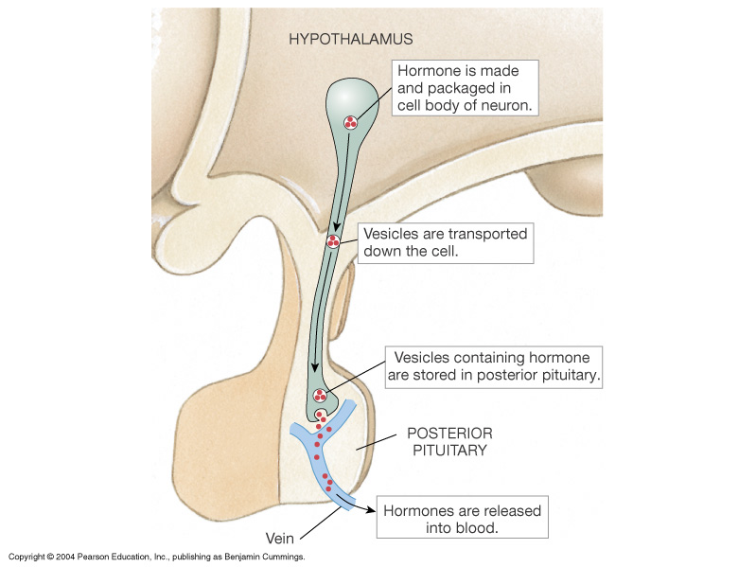
Secretion of Posterior Pituitary Hormones

Slide 59
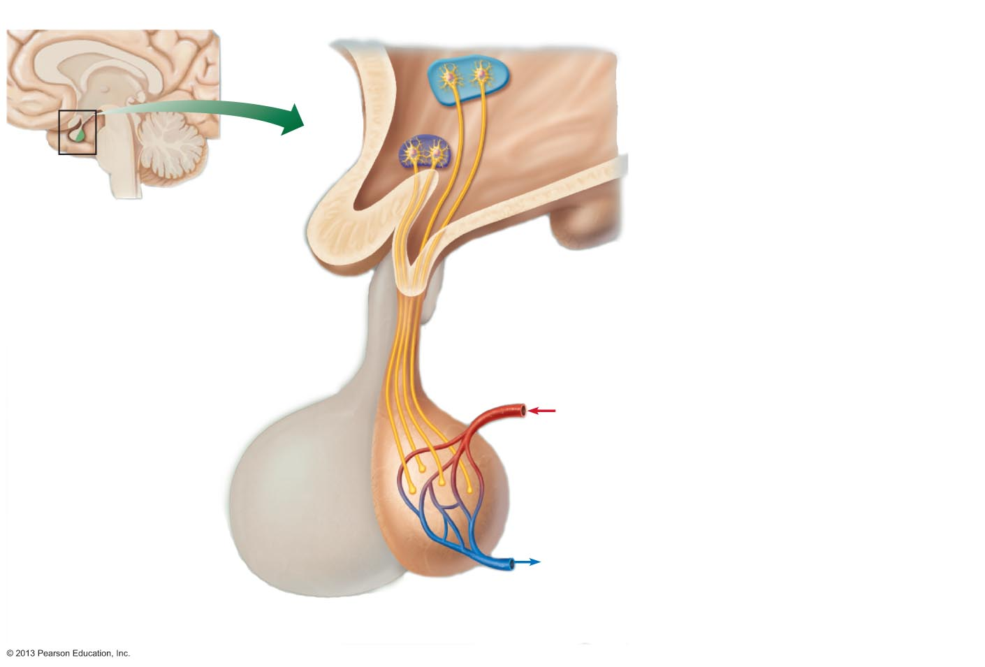
Figure 16.5a The hypothalamus controls release of hormones from the pituitary gland in two different ways (1 of 2).
Slide 1
Paraventricular nucleus
Hypothalamus
1
Hypothalamic neurons synthesize oxytocin or antidiuretic hormone (ADH).
Posterior lobe
of pituitary
Optic
chiasma
Supraoptic
nucleus
Infundibulum
(connecting stalk)
2
Oxytocin and ADH are transported down the axons of the hypothalamic- hypophyseal tract to the posterior pituitary.
Inferior
hypophyseal
artery
Hypothalamic-
hypophyseal
tract
Axon terminals
3
Oxytocin and ADH are stored in axon terminals in the posterior pituitary.
Posterior lobe
of pituitary
4
Oxytocin
ADH
When hypothalamic neurons fire, action potentials arriving at the axon terminals cause oxytocin or ADH to be released into the blood.
Notes:
The paraventricular nucleus (PVN, PVA, or PVH) is a nucleus in the hypothalamus.^{[1]} It is a group of neurons that can be activated by physiological changes including stress. Many PVN neurons project directly to the posterior pituitary where they release oxytocin into the general circulation. While the supraoptic nucleus releases vasopressin. Both the PVN and the supraoptic nucleus do produce small amounts of the other hormone, ADH and Oxytocin respectively. Other PVN neurons control various anterior pituitary functions.

Slide 60
Oxytocin
Is synthesized as the precursor hormone: prepro-oxyphysin
Acts primarily on the mammary gland and uterus
Increases contraction of smooth muscle of the vas deferens
Secretion is increased during labor
May also act to facilitate sperm transport in uterus (non-pregnancy state)
Notes:
محرک اصلی برای ترشح این هورمون ایمپالس عصبی از نوک پستانها میباشد. همچنین اتساع واژن و رحم نیز موثر میباشد. این محرکها همچنین باعث ترشح پرولاکتین نیز میشود. به همین علت برخی اوقات اکسی توسین را عامل آزاد کننده پرولاکتین در نظر میگیرند.
استروژن تولید اکسیتوسین و نوروفیزین یک را تحریک کرده و پروژسترون عملکرد مهاری دارد.
مکانیسم اثر:
محتمل ترین وظیفه اکسی توسین تحریک تنقباضات سلولهای میواپیتلایل دور آلوئلهای پستان میباشد. گیرنده های اکسی توسین هم در بافت رحم و هم در بافت پستان دیده شده اند.
استروژنها تعداد این گیرنده ها افزایش داده و پروژسترون تعداد آنها را کم میکند.
درست قبل از زایمان استروژنها افزایش یافته و پروژسترون کاهش میابد به همین دلیل پیش از زایمان شیرسازی آغاز میشود.

Slide 61
Posterior Pituitary: Regulation of Osmolality
Plasma osmolality is monitored by osmoreceptors in the hypothalamus
Increases in plasma osmolality stimulates secretion of vasopressin
Small changes above the normal plasma osmotic pressure stimulate release of vasopressin

Slide 62
Vasopressin (ADH)
Is also known as antiduretic hormone (ADH)
Participates in body water regulation (Water is lost from lungs, sweat, feces and urine on a daily basis)

Slide 63
Vasopressin (ADH) Secretion
Secretion is Stimulated by:
1. Large decreases in blood volume
2. Decreases in blood pressure
3. Pain, fear, trauma, and stress
Notes:
محرک اصلی فیزیولوژیک برای ترشح وازوپرسین افزایش اسمولاریته پلاسما میباشد.
این تحریک به واسطه گیرنده های اسمزی هیپوتالاموس و گیرنده های فشار قلب و سایر قسمتهای دستگاه قلبی عروقی انجام میشود.
از محرکهای دیگر میتوان به هیجان، استیل کولین، نیکوتین و مورفین اشاره کرد.

Slide 64
Vasopressin Activity
Decreases water excretion by kidneys (V₂ receptors)
Constricts blood vessels (V₁ receptors)- arteriolar smooth muscle
Increases adrenocorticortropin hormone (V_{1B} receptors) secretion from the anterior pituitary
Notes:
مهم ترین سلولهای هدف وازوپرسین سلولهای توبول دیستال و لوله های جمع کننده کلیه میباشد. دو نوع گیرنده V1 و V2 وجود دارد.
گیرندهای V2 فقط در سطح سلولهای اپیتلیال کلیه وجود دارند در این گیرنده ها انتقال پیام به واسطه cAMP انجام میشود.
تمام گیرنده های خارج کلیوی از نوع V1 میباشد. اتصال وازوپرسین به V1 باعث فعال شدن فسفولیپاز C و در نتیجه IP3 و DAG شده و غلظت یون کلسیم را افزایش میدهد و باعث فعال شدن پروتئین کیناز C میشود که نتیجه آنها انقباض عضله صاف عروق میباشد.

Slide 65
هورمونهای تیروئیدی
T3 و T4 در خون توسط گلوبین متصل شونده به تیروکسین (TBG) و پره آلبومین متصل شونده به تیروکسین (TBPA) منتقل میشوند
TBG 100 برابر قویتر از TBPA به T3 و T4 متصل میشوند.
نیمه عمر پلاسمایی T4 چهار تا پنج برابر T3 میباشد
در سنجش های کلینیکی مقدار کل T3 و T4 گزارش میشود نه فرم آزاد آنها
استروژنها باعث افزایش ساخت TBG کبدی و آندروژن ها و گلوکوکورتیکوئیدها باعث کاهش آن میشود.
T4 با دیدیناسیون در خارج از تیروئید تبدیل به T3 میشود
میل ترکیبی T3 با گیرنده سلولهای هدف 10 برابر بیشتر است.
Notes:
در شرایط طبیعی تقریبا تمامی T3 و T4 به TBG اتصال میابند و بخشی از آنها به صورت آزاد دیده میشوند که مسئولیت فعالیت بیولوژیک هورمون را دارند
نیمه عمر پلاسمایی T4 چهار تا پنج برابر T3 میباشد ولی نیمه عمر T4 و T3 آزاد با هم برابر هستند
میل ترکیبی T3 با گیرنده غشا سلولی سلولهای هدف 10 برابر بیشتر است. T3 را از نظر فعالیت فرم غالب در نظر میگیرند. حدود 80 درصد از T4 گردش خون به T3 یا rT4 تبدیل میشوند.

Slide 66
هورمونهای تیروئیدی
هورمونهای تیروئیدی به گیرنده ای در هسته سلولهای هدف متصل میشوند
میل ترکیبی بالای T3 (10 برابر بیشتر از T4) باعث بالاتر بودن فعالیت زیستی آن نیز شده است
کمپلکس گیرنده-هورمون با اتصال به نواحی HRE باعث تغییر بیان ژن سلولهای هدف میشود
هورمون T3 باعث افزایش بیان ژن GH میشود
هورمونهای تیروئیدی در فرایندهای تکاملی نقش مهمی دارند
هیپوتیروئیدی داخل رحمی یا نوزادی باعث Cretinism میشود که در آن نقایص متعدد مادرزادی و عقب ماندی شدید ذهنی ایجاد میشود
Notes:
هورمون T3 باعث افزایش بیان ژن GH میشود به همین علت است که هورمونهای تیروئیدی با سوخت و ساز و متابولیسم بدن ارتباط مستقیم دارند

Slide 67
پاتوفیزیولوژی بیماریهای تیروئیدی
بزرگی تیروئید (گواتر)
هیپوتیروئیدی (کاهش هورمونهای تیروئیدی) عدم کافی بودن T3 و T4
ممکن است به علت مشکل در هیپوفیز یا هیپوتالاموس باشد یا میزان کم ید دریافتی بدن
عوارض هیپوتیروئیدی: کاهش پیدا کردن متابولیسم پایه، کاهش ضربان قلب، رفتار کند، خواب آلودگی، یبوست، خشکی پوست و موها، در اواخر کودکی باعث قد کوتاه میشود ولی باعث عقب ماندگی ذهنی نمیشود
هیپرتیروئیدی (افزایش هورمونهای تیروئیدی)
علایم بیماری: تندی ضربان قلب، افزایش فشار نبض، عصبانیت، ناتوانی در خواب، کاهش وزن و افزایش اشتها به طور توام، ضعف، تعریق زیاد و حساسیت به گرما
Notes:
بزرگی تیروئید یا گواتر نشان دهنده فعالیت بدن برای جبران کاهش هورمون توسط تیرئید میباشد.
هیپرتیروئیدی (افزایش هورمونهای تیروئیدی) در آمریکا به علت بیماری grave ایجاد میشود که بر ضد گیرنده TSH IgG ساخته شده و آن را فعال میکند. در نتیجه تیروئید بزرگ شده مقادیر کنترل شده T3 و T4 ساخته میشود

Slide 68
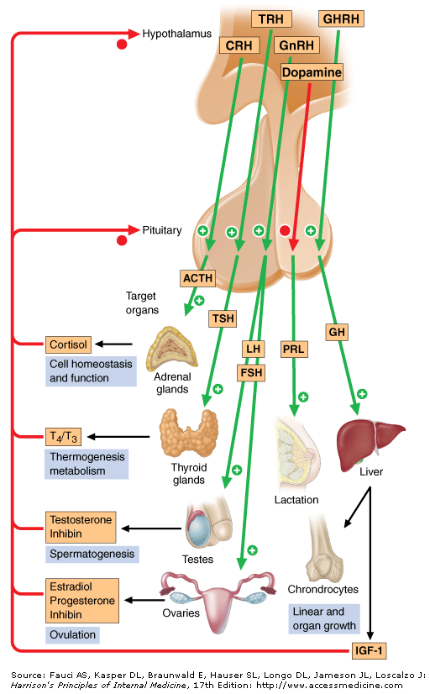
Hypothalamic and
Pituitary Hormones
Hypothalamic hormones
regulate anterior pituitary
trophic hormones that, in
turn, determine target
gland secretion.
There is a
peripheral hormones
feedback which regulates
hypothalamic and
pituitary hormones.

Slide 69
Hormonal Stimuli
Hormones stimulate other endocrine organs to release their hormones
  Hypothalamic hormones stimulate release of most anterior pituitary hormones
  Anterior pituitary hormones stimulate targets to secrete still more hormones
  Hypothalamic-pituitary-target endocrine organ feedback loop: hormones from final target organs inhibit release of anterior pituitary hormones

Slide 70
The Pituitary Gland and Hypothalamus
Pituitary gland (hypophysis) has two major lobes
  Posterior pituitary (lobe)
    Neural tissue
  Anterior pituitary (lobe) (adenohypophysis)
    Glandular tissue

Slide 71
Posterior Pituitary and Hypothalamic Hormones
Oxytocin and ADH
  Each composed of nine amino acids
  Almost identical – differ in two amino acids

Slide 72
Corticotropin releasing hormone (CRH) –
corticoliberin, is a hypothalamic polypeptide for
diagnostic use. It increases ACTH secretion in
Cushing's diseas.
Natural corticotropin (ACTH) is a 39-amino-acid
polypeptide secreted by the anterior pituitary gland,
obtained from animal pituitaries. The physiological
activity resides in the first 24-amino acids (which
are common to many species) and most of the immu-
nological activity resides in the remaining 15 amino
acids. The pituitary output of corticotropin responds
rapidly to physiological requirements by the
familiar negative-feedback homeostatic mechanism.

Slide 73
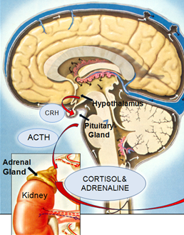
Corticotropin stimulates the synthesis of corticosteroids (of
which the most important is hydrocortisone) and to a lesser
extent of androgens, by the cells of the adrenal cortex. It has
only a minor effect on aldosterone production. The release of
natural corticotropin by the pituitary gland is controlled by the
hypothalamus via corticotropin
releasing hormone (corticoliberin),
production of which is influenced
by stress as well as by the level
of circulating hydrocortisone.

Slide 74
High plasma concentration of any steroid with glucocorticoid effect prevents release of corticotropin releasing hormone as well as of ACTH, the lack of which in turn results in adrenocortical hypofunction.
This is the reason why catastrophe may follow the sudden withdrawal of steroid therapy in the chronically treated patient who has an atrophied cortex.
The effects of corticotropin are those of the steroids (hydrocortisone, androgens) liberated by its action on the adrenal cortex. Prolonged heavy dosage causes Cushing's syndrome.
Tetracosactide (Synacthen®) is used as a test of the capacity
of the adrenal cortex to produce cortisol (hydrocortisone).

Slide 75
Thyrotropin releasing hormone (TRH) –
protirelin, is a thripeptide formed in the hypo-
thalamus and controlled by free plasma T4
and T3 concentration. It has been synthesized
and can be used in diagnosis to test the
capacity of the pituitary to release thyroid
stimulating hormone, e.g. to determine
whether hypothyroidism is due to primary
thyroid gland failure or is secondary to pituitary
disease or to a hypothalamic lesion. TRH is
also a potent prolactin-releasing factor.

Slide 76
Thyroid stimulating hormone (TSH) thyrotropin,
a glycoprotein of the anterior pituitary,
controls the synthesis and release of thyroid
hormone from the gland, and also the uptake of
iodide. There is a negative feedback of thyroid
hormones on both the hypothalamic secretion of
TRH and pituitary secretion of TSH.
Sermorelin is an analogue of the hypothalamic
growth hormone releasing hormone (somatorelin).
It is used in a diagnostic test for growth hormone
secretion from the pituitary.

Slide 77
Growth hormone (GH), one of the peptide hormones
produced by the anterior pituitary, is required during
childhood and adolescence for attainment of normal
adult size and has important effects throughout post-
natal life on lipid and carbohydrate metabolism, and
on body mass. Its effects are primarily mediated via
insulin-like growth factor 1 (IGF-1) and IGF-2.
Individuals with congenital or acquired deficiency in
GH during childhood or adolescence fail to reach
their predicted adult height and have disproportionately
increased body fat and decreased muscle mass.
Adults with GH deficiency also have disproportionately
small body mass.

Slide 78

Gonadorelin (gonadotropin releasing hormone –
GnRH) releases luteinising hormone (LH) and
follicle-stimulating hormone (FSH). It has
use in the assessment of pituitary function. Intermittent
pulsatile administration evokes secretion of
gonadotropins (LH and FSH) and is used to treat
infertility. But continuous use evokes tachyphylaxis
due to down-regulation of its receptors, i.e.
gonadotropin release and therefore gonadal
secretions are reduced.
Longer-acting analogues – agonists of GnRH
(buserelin, goserelin, nafarelin, deslorelin, and leuprorelin)
are used to suppress androgen secretion
in prostatic carcinoma.

Slide 79
Prolactin is secreted by the lactotroph cells of the
anterior pituitary gland. Its control is by tonic
hypothalamic inhibition through prolactin inhibitory
factor (PIF), probably dopamine, opposed by a
prolactin releasing factor (PRF) in both women and
men and, despite its name, it influences numerous
biological functions. Prolactin secretion is
controlled by an inhibitory dopaminergic path. Hyper-
prolactinaemia may be caused by drugs (with anti-
dopaminergic actions e.g. metoclopramide), hypo-
thyroidism, or prolactin secreting adenomas. Medical
treatment is with bromocriptine, cabergoline, or
quinagolide at bedtime.

Slide 80
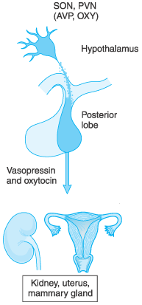
Hypothalamic neurons
in the supraoptic (SON)
and paraventricular (PVN)
nuclei synthesize arginine
vasopressin (AVP) or
oxytocin (OXY).
Most of their axons project
directly to the posterior
pituitary, from which AVP
and OXY are secreted into
the systemic circulation to
regulate their target tissues.
Goodman & Gilman's The Pharmacologic
Basis of Therapeutics – 11th Ed. (2006)

Slide 81
Vasopressin is a nonapeptide (t_{1/2} 20 min) with
two separate G-protein coupled target receptors
responsible for its two roles. The V₁ receptor on
vascular smooth muscle is coupled to calcium
entry. This receptor is not usually stimulated by
physiological concentrations of the hormone.
The V₂ receptor is coupled to adenylyl cyclase, and
regulates opening of the water channel, aquaporin,
in cells of the renal collecting duct.
Secretion of the antidiuretic hormone is stimulated
by any increase in the osmotic pressure of the blood
supplying the hypothalamus and by a variety of
drugs, notably nicotine. Secretion is inhibited by a fall
in blood osmotic pressure and by alcohol.
Notes:
An oligopeptide containing nine amino acyl residues

Slide 82
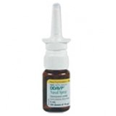
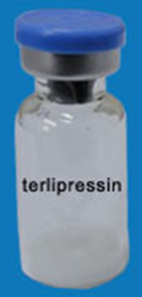
The main complication of DDAVP is hyponatraemia
which can be prevented by allowing the patient
to develop some polyuria for a short period
during each week. The requirement for DDAVP
may decrease during intercurrent illness.
Terlipressin is an analogue of vasopressin
used in NA-resistant septic shock and
esophageal varices.
Oxytocin is a peptide hormone of the posterior
pituitary gland. It stimulates the contractions of the
pregnant uterus, which becomes much more sensitive
to it at term. Patients with posterior pituitary disease
(diabetes insipidus) can, however, go into labour normally.

Slide 83
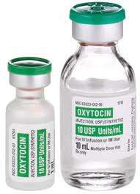
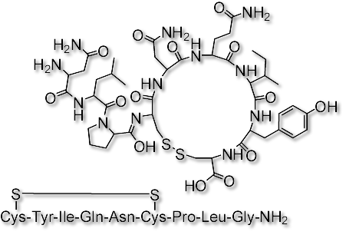
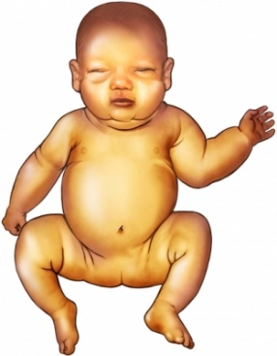
Oxytocin is structurally close to vasopressin
and it is no surprise that it also has antidiuretic
activity. Serious water intoxication can
occur with prolonged i.v. infusions, especially
where accompanied by large volumes of fluid.
The association of oxytocin with neonatal
jaundice appears to be due to increased
erythrocyte fragility causing haemolysis.
Oxytocin has been supplanted by the
Methylergometrine (Methergin®), as the prime
treatment of postpartum haemorrhage.
Neonatal jaundice

Slide 84
Corticotropin releasing hormone (CRH) –
corticoliberin, is a hypothalamic polypeptide for
diagnostic use. It increases ACTH secretion in
Cushing's diseas.
Natural corticotropin (ACTH) is a 39-amino-acid
polypeptide secreted by the anterior pituitary gland,
obtained from animal pituitaries. The physiological
activity resides in the first 24-amino acids (which
are common to many species) and most of the immu-
nological activity resides in the remaining 15 amino
acids. The pituitary output of corticotropin responds
rapidly to physiological requirements by the
familiar negative-feedback homeostatic mechanism.

Slide 85
Corticotropin stimulates the synthesis of corticosteroids (of
which the most important is hydrocortisone) and to a lesser
extent of androgens, by the cells of the adrenal cortex. It has
only a minor effect on aldosterone production. The release of
natural corticotropin by the pituitary gland is controlled by the
hypothalamus via corticotropin
releasing hormone (corticoliberin),
production of which is influenced
by stress as well as by the level
of circulating hydrocortisone.

Slide 86
High plasma concentration of any steroid with glucocorticoid effect prevents release of corticotropin releasing hormone as well as of ACTH, the lack of which in turn results in adrenocortical hypofunction.
This is the reason why catastrophe may follow the sudden withdrawal of steroid therapy in the chronically treated patient who has an atrophied cortex.
The effects of corticotropin are those of the steroids (hydrocortisone, androgens) liberated by its action on the adrenal cortex. Prolonged heavy dosage causes Cushing's syndrome.
Tetracosactide (Synacthen®) is used as a test of the capacity
of the adrenal cortex to produce cortisol (hydrocortisone).

Slide 87
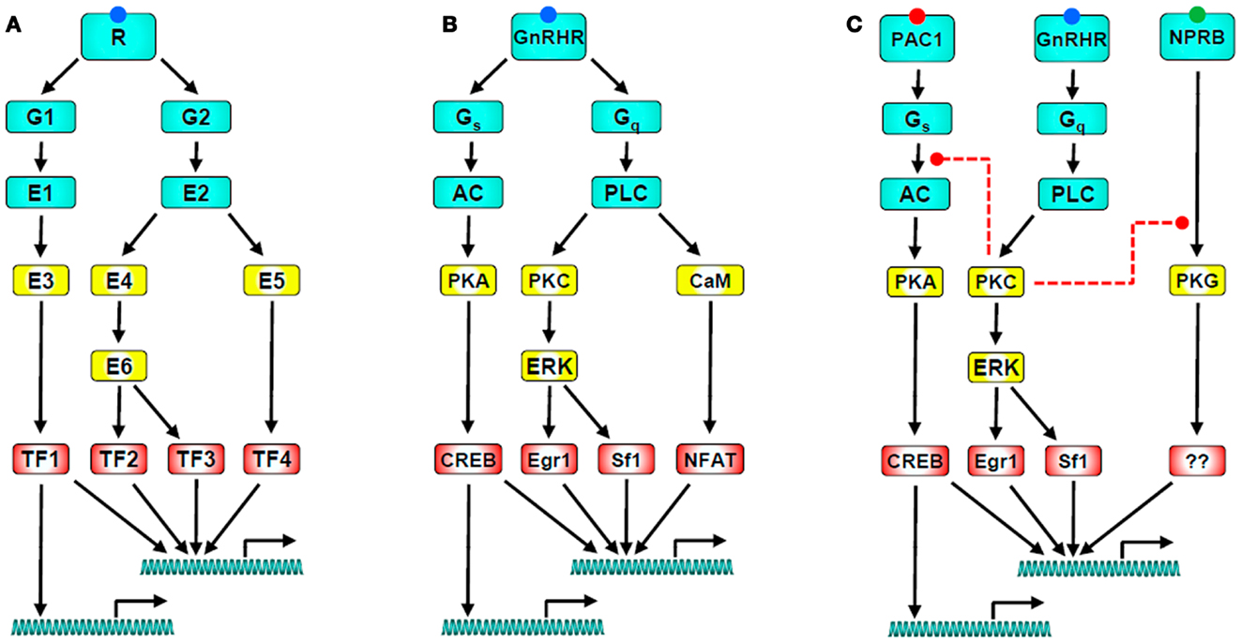
Notes:
https://www.frontiersin.org/articles/10.3389/fendo.2013.00180/full

Slide 88
Endocrine Control: Three Levels of Integration
Hypothalamic stimulation–from CNS
Pituitary stimulation–from hypothalamic trophic Hs
Endocrine gland stimulation–from pituitary trophic Hs

Slide 89
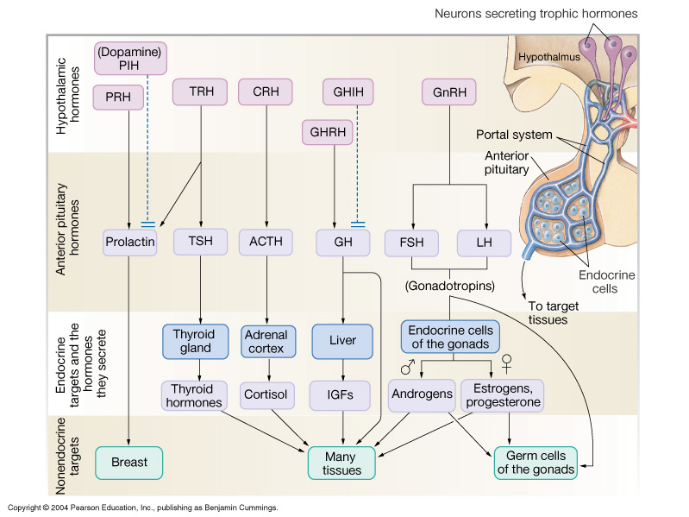
Endocrine Control: Three Levels of Integration

Slide 90
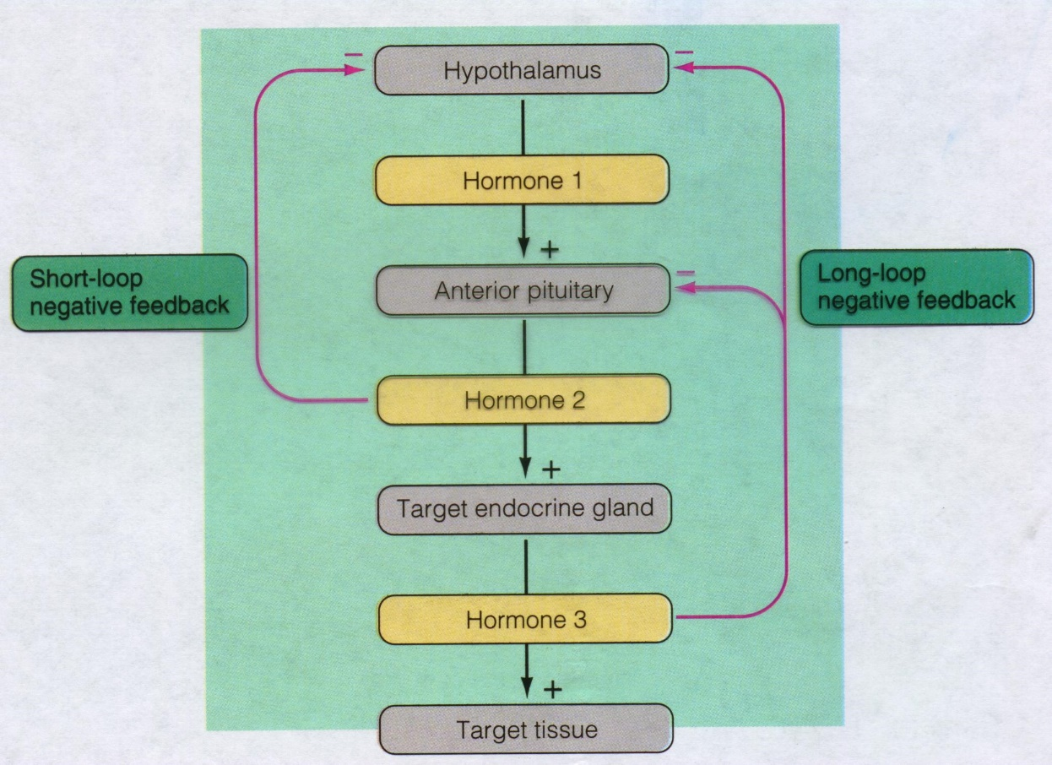
Feedback Control of Anterior Pituitary

Slide 91
Two hypothalamic factors,
growth hormone-releasing
hormone (GHRH) and
somatostatin (SST),
act on the somatotropes in
the anterior pituitary to
regulate GH secretion. SST
also inhibits GHRH release.
Ghrelin is a potent
stimulator
of GH release.
Notes:
گرلین یا هورمون گرسنگی توسط سلولهای ghrelinergic در لوله گوارشی ساخته میشود.

